Slide 1
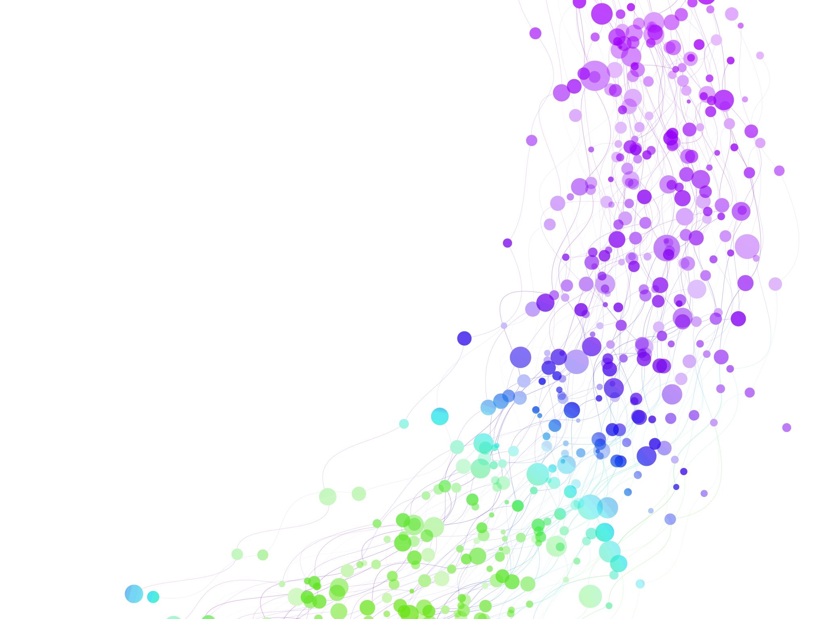
Child Development Information System (CDIS)
CDIS Clinical & Admin User Group
June 2024

Slide 2
Agenda
Tips and Tricks
      Deleting an attachment
      SMS reminders
      Site request forms
Family Consult
End of financial year preparation:
      Data Cleansing
      Data Reporting

Slide 3
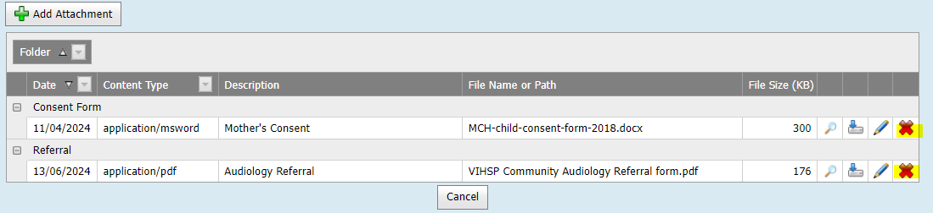
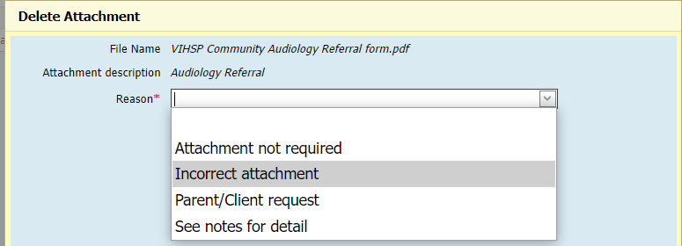
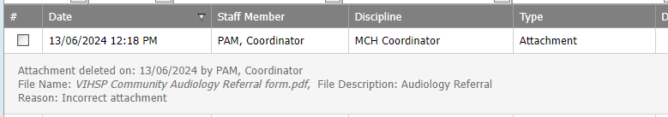
Tips & Tricks
Deleting an attachment from a CDIS history
Coordinators/Team Leaders can delete an attachment that has been incorrectly attached to the wrong CDIS history by clinicians or admin staff.

Slide 4
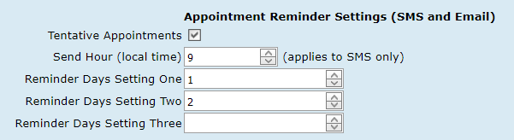
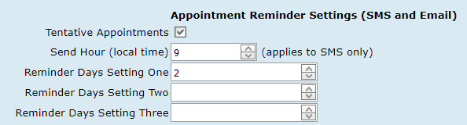
Tips & Tricks
SMS Reminders: The correct way to change SMS appointment reminder settings, from 1 day, to 2 days before appointments, and ensure clients do not miss a day worth of SMS reminders, is to have a transition day:
Steps:
1. Day 1 - After 10am - Update your SMS settings to the following:
Reminder Days Setting One = 1
Reminder Days Setting Two = 2
2. Day 2 - After 10am - Update your SMS settings to the following:
Reminder Days Setting One = 2
Reminder Days Setting Two = [Blank]

Slide 5
Tips & Tricks
CDIS Site Request forms
Please follow the instructions clearly on the CDIS site request form.
This will ensure that the process runs smoothly

Slide 6
Family Consult Tips
Best practice is to complete the Family Consult in the parents CDIS record who disclosed family violence.
Reference the disclosure in the child/children's history stating that “Family violence disclosed see (name, relationship and CDIS number) notes as well as any direct impacts on the child observed or disclosed.
Safety Plans to be completed in the parents' history within the Family Consult and within the children's history.
In the Annual Report, the number of MARAM Family Violence (FV) Assessments completed, are recorded when they are completed within the Family Consultations.
In the KAS Report, the number of Family violence or Safety Plans are counted from within the KAS consult, and if completed during or within 7 days following the consultation.
Any MARAM and safety plans recorded in a EMCH consult or additional consult will not appear in these reports.
Note: important to ensure that if MARAM and Safety Plans are needed to be completed in these consults a Family Consult is to be used.

Slide 7
Family Consult – CDIS Consultation Process
Family consultations
The additional family consultation aims to increase capacity within the MCH Service to provide greater family violence support to families. Family consultations are an additional one hour of service for reasons related to family violence including:
where family violence has been disclosed
where family violence is suspected
where there has been no prior opportunity to ask about family violence.
The MARAM Family Violence Assessment tool is to be used as part of the Family Consultation and if there is disclosure of Family Violence, the Safety Plan must be completed.
It is important that accurate data is collected for the number of and time required to conduct the family consultation. Although the nurse may be conducting a KAS which is an appointment in the calendar, if the need to undertake a Family Consultation becomes evident, the nurse must ensure that a separate consultation is used to document the Family Consultation.
This can be done by completing and saving the current consultation first undertaking the Family Consultation.
The Family Consultation should be added to the calendar to ensure that the calendar reflects the work undertaken by the nurse for that day.
The time for conducting each consultation must be accurately documented. This may require you to book the family for an additional consultation to complete the KAS which could not be completed due to the disclosure.
A Family Consultation may also be booked into the calendar as a stand-alone appointment if the nurse considers that one of the indicators for the consultation listed above have been met.
Note: Do not document family violence information as part of the KAS unless 4-week KAS.
Documentation regarding the detailed family violence is recorded in the child/ren’s and parent/carers record – unless in the judgement of the nurse there are extenuating circumstances why this would not be appropriate. In these circumstances documentation in child’s notes is required stating “Family violence disclosed see (name, relationship and CDIS number) notes as well as any direct impacts on the child observed or disclosed.
Safety plans are documented in the child/ren’s and parent/carers notes.

Slide 8

Data Cleansing

Slide 9
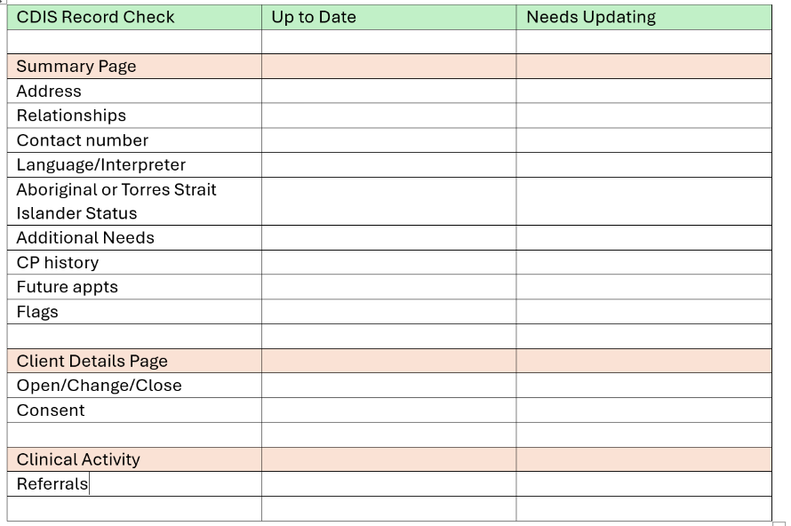
CDIS Housekeeping – its everyone's responsibility
To ensure data is accurate it is critical that data is monitored and regularly cleansed.
Every time you are in a CDIS history:

Slide 10
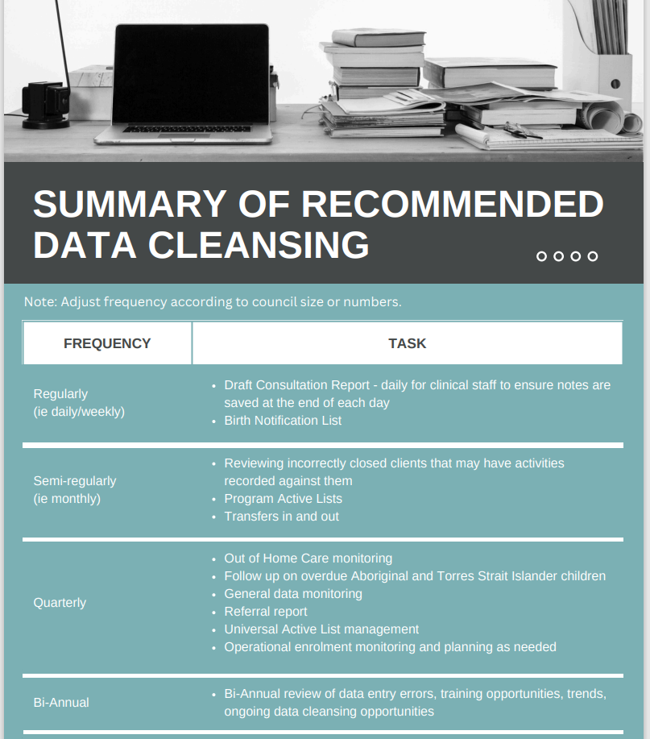
Notes:
If the draft consultations are not completed by the close of business at the end of financial year, then they do not appear on the annual report? Given also that the 30th June is a Sunday, and some services work a Saturday it might be critical to remind everyone.

Slide 11
Resource to support Data Cleansing
MCH CDIS Education – Data Cleansing vimeo
https://vimeo.com/690719160?share=copy
2022 July CDIS User Groups - CDIS House keeping

Slide 12
Annual reporting
The Victorian Maternal and Child Health (MCH) annual data collection occurs following the completion of the financial year.
As per the service agreement requirements, all organisations receiving funding to deliver a MCH Service are required to provide annual reporting data.
MCH Leadership is responsible for the annual reporting data and sending to DH.
Clinical reporting data is found on the MCH electronic records system (currently CDIS).
Best practice is that the reports are run BEFORE anyone logs on the 1st July - a Monday this year. Hint: Workforce can be completed on the week before.
The MCH Annual Report includes information on:
    Universal MCH Program
    Sleep and Settling Initiative
    Enhanced MCH Program
    KAS Report
    Workforce
Remember, data in some CDIS reports updates overnight
Notes:
It should be noted that The Annual Report runs off a "summary table" in CDIS. The data in this table is refreshed every night by an overnight process.
The purpose of the summary table is to make generating the reports faster/more efficient and take processing load off the database during business hours.
This means, as an example, if data was to show for 1 July, it must be entered into CDIS on or before 30 June.

Slide 13
Q : How come I have different client numbers in my group attendance compared to my group on the calendar?
Asked in Admin User Group
Ensure that all Future Dates are ticked.
Follow group process step by step; it is complex.
IF you don’t follow the process, it can be easily set up incorrectly
child-development-information-system-initial-group-set-up-process.docx (live.com)

Slide 14
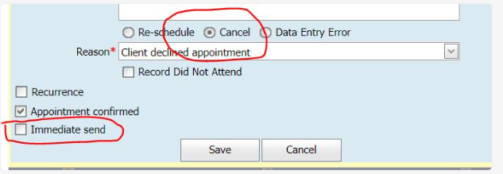
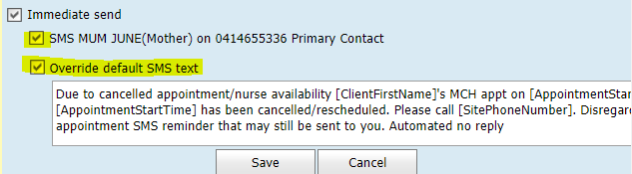
Can this cancelled appointment initiate an immediate send of the cancellation?
Asked in both User Groups
Unfortunately, cancelling a scheduled appointment or recording it as DNA, is not linked to the Appointment Reminders for SMS/Email
Suggest using ‘Override default SMS text’ to change the SMS/Email message, to alert carers to ignore messages after a cancelled or rescheduled appointment:
Due to cancelled appointment/nurse availability [ClientFirstName]'s MCH appt on [AppointmentStartDate] [AppointmentStartTime] has been cancelled/rescheduled. Please call [SitePhoneNumber]. Disregard appointment SMS reminder that may still be sent to you. Automated no reply

Slide 15
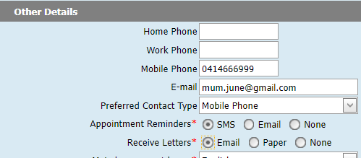
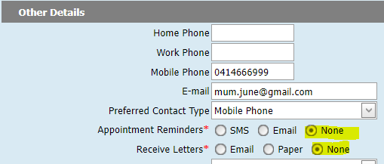
Removing the contact details of a family that are choosing not to engage with your MCH service but may return to the service?
Question from Clinical User Group
To edit this, from within a client record go to the Menu Client Details > Update Client Details
Scroll down to Other Details
You can leave the Preferred contact Type as is, for historical reasons if desired, or clear it by clicking on the drop-down list and selecting the blank option at the top of the list.
Edit the Radio buttons;
Appointment Reminders – set to None
Receive Letters - set to None
Scroll down and click Save

Slide 16
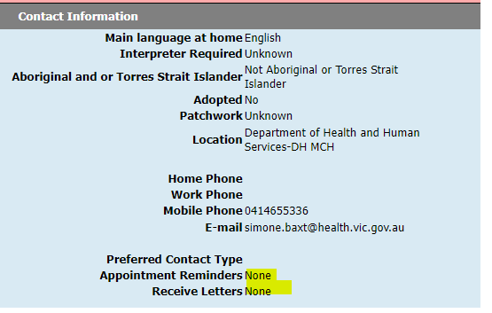
This is the contact information for a PCG when they DO NOT wish to receive correspondence.

Slide 17
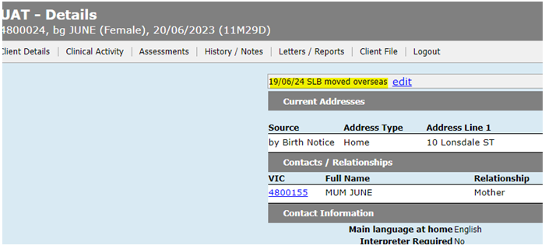
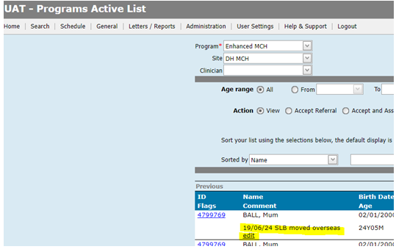
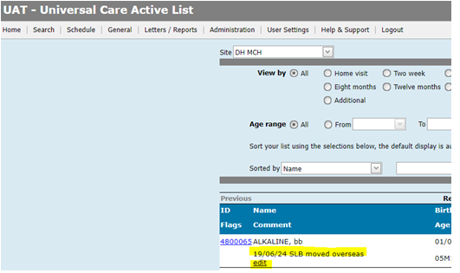
Using edit fields to note family information
Update all family members hx.
Discussed at Clinical group – remember to date and initial. This is not saved in the notes

