Slide 1
Sebastian King
Paediatric Constipation
Director
Colorectal and Pelvic Reconstruction Service
Notes:
Introduction – why Constipation. PhD – Lord of the Ring, Rear Admiral, Poo-diatrician

Slide 2


Slide 3


Slide 4
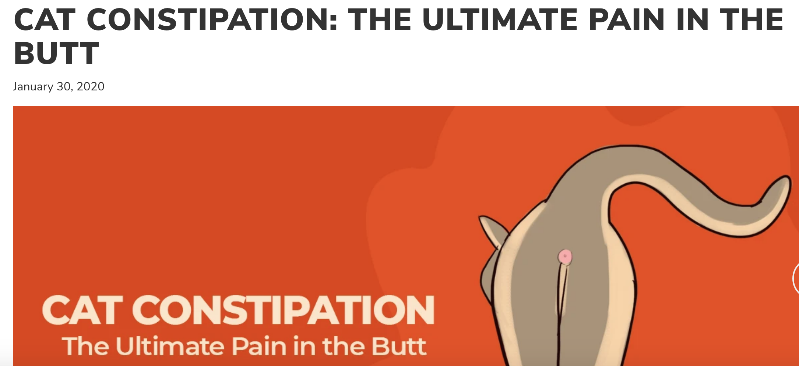

Slide 5
Paediatric Constipation
Definitions
Extent of the condition
Presentations – age based
Simple treatments
When to refer
Investigations
Interventions
Questions?

Slide 6
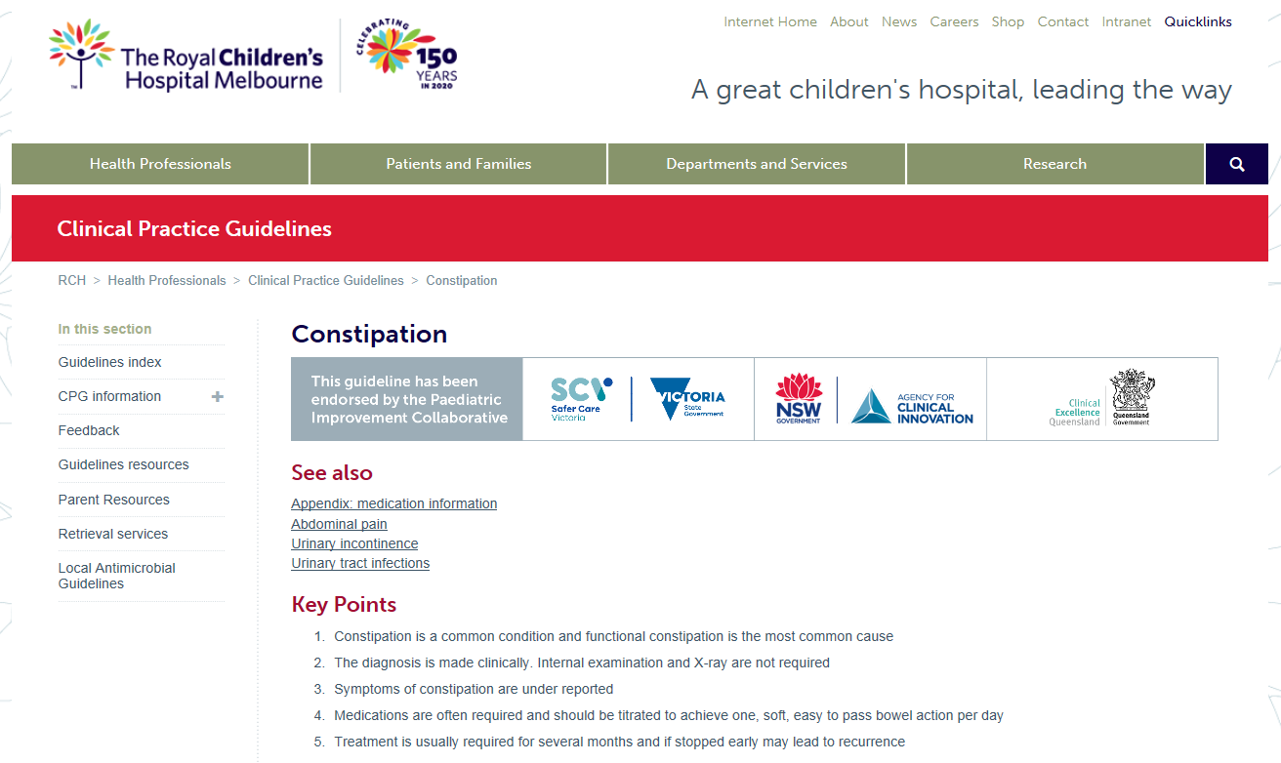
Definitions

Slide 7
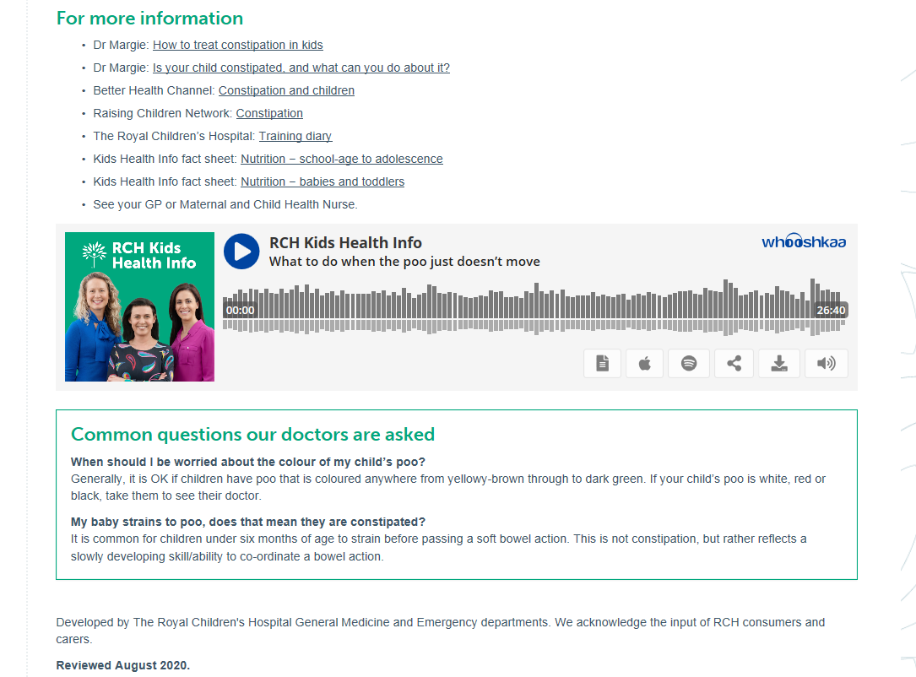
Definitions

Slide 8
Rome IV

Slide 9
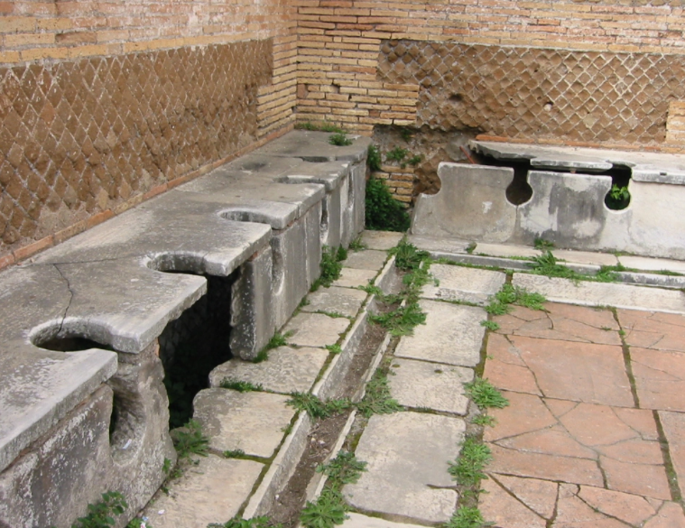
Rome IV

Slide 10
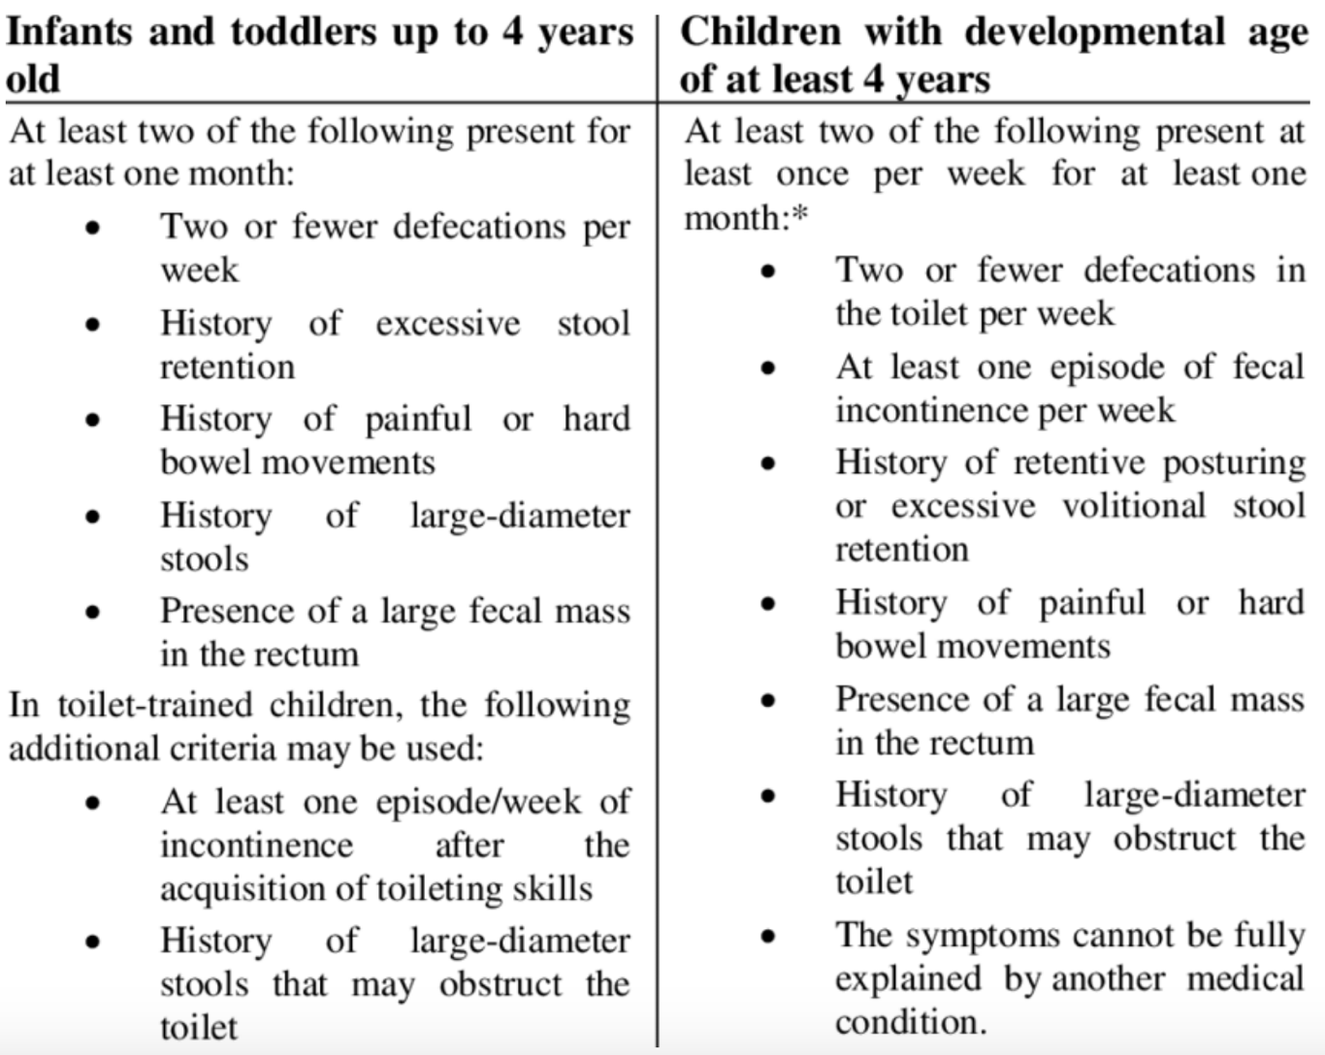
Rome IV Criteria

Slide 11
How common is constipation?
Affects up to 30% of children
Most children respond to simple treatments
Most children need no investigations

Slide 12
How common is chronic constipation?
Affects 3-8% of children
Up to 25% of paediatric GI appointments
Most children need more involved treatments
Some children need further investigations

Slide 13
How does constipation present?
Age based

Slide 14
How does constipation present?
Age based
Antenatal – rare presentations
  IVF vs natural conception
  dilated bowel loops on ultrasound
  family history of Hirschsprung disease

Slide 15
How does constipation present?
Age based
Neonates (0 – 1 month)
  failure to pass meconium (< 24 hours)
  not true “constipation”
  may be related to a cows’ milk protein allergy
  rarely related to Hirschsprung disease
  referral for surgical review

Slide 16
How does constipation present?
Age based
Infant (1 – 12 months)
  variable patterns with breast milk vs formula
  often worsens with weaning of breast milk
  often worsens with introduction of solids

Slide 17
How does constipation present?
Age based
Toddlers (13 – 36 months)
  following move to new childcare
  following arrival of new family member
  following trials of toilet training

Slide 18
How does constipation present?
Age based
Pre-school (37 – 60 months)
  following move to new childcare
  following arrival of new family member
  following trials of toilet training
  worsening parental anxiety

Slide 19
COVID
Less presentations?
Better management at home?
Parents more able to pay attention

Slide 20

COVID
Adults
  Increased difficulties!

Slide 21
Constipation – Simple Treatments
What will parents have tried?
  bicycle legs
  abdominal massage
  perianal stimulation
  suppositories

Slide 22
Constipation – Simple Treatments
What will parents have tried?
  bicycle legs
  abdominal massage
  perianal stimulation
  suppositories
  and 50 different treatments for colic!

Slide 23
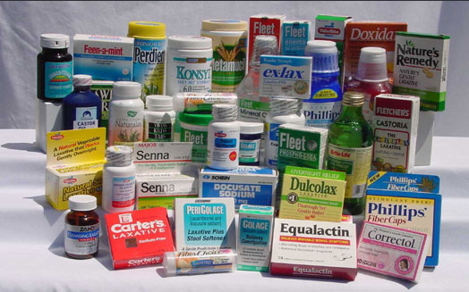
Constipation – Simple Treatments

Slide 24
Constipation – Simple Treatments
What do I prefer?
Lactulose (Actilax/Duphalac)
  non-absorbable sugar
  increases stool content
  softens the stool

Slide 25
Constipation – Simple Treatments
What do I prefer?
Parachoc
  50% liquid paraffin
  lubricates the stool
  softens the stool

Slide 26
Constipation – Simple Treatments
What do I not use?
Coloxyl + Senna
  Senna is a propulsive agent (may cause cramps)

Slide 27
When to refer?
Anatomical concerns
  anus appears to be in the wrong position

Slide 28
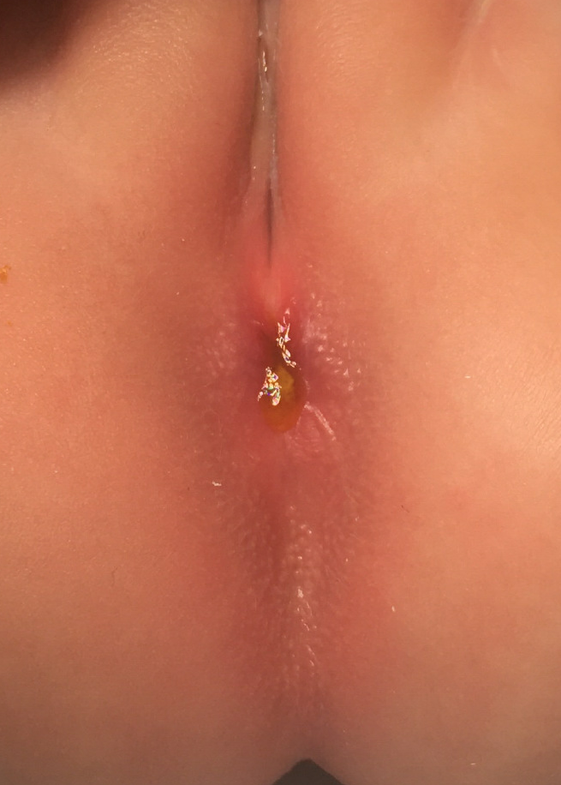
When to refer?
Anatomical concerns

Slide 29
When to refer?
Anatomical concerns
  anus appears to be in the wrong position
  abnormal skin tags/lesions near anus

Slide 30
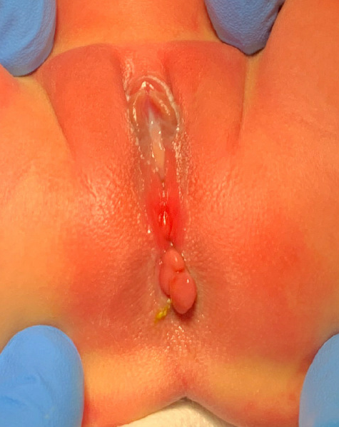
When to refer?
Anatomical concerns

Slide 31
When to refer?
Anatomical concerns
  anus appears to be in the wrong position
  abnormal skin tags/lesions near anus
  abdominal distension with explosive stools

Slide 32
When to refer?
Anatomical concerns
  anus appears to be in the wrong position
  abnormal skin tags/lesions near anus
  abdominal distension with explosive stools
Failure of simple treatments (3-6 months)

Slide 33
The role of basic investigations
Abdominal x-ray
  rarely useful in non-surgical situations

Slide 34
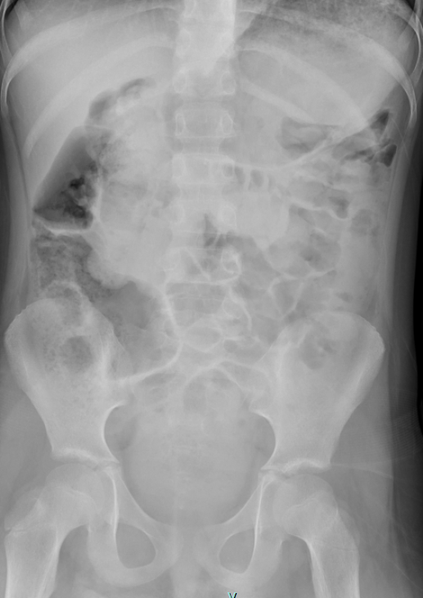
The role of basic investigations
Abdominal x-ray

Slide 35
The role of basic investigations
Abdominal x-ray
  rarely useful in non-surgical situations
Blood tests
  thyroid function tests rarely indicated

Slide 36
Constipation – Further Treatments
What do I prefer?
Osmolax or Movicol
  both polyethylenegycol (PEG) derivatives
  variable presentations
  variable tastes

Slide 37
Constipation – Further Treatments
What do I prefer?
Osmolax or Movicol
  both polyethylenegycol (PEG) derivatives
  variable presentations
  variable tastes
  safe in children < 24 months

Slide 38
The role of further investigations
Rectal biopsy

Slide 39
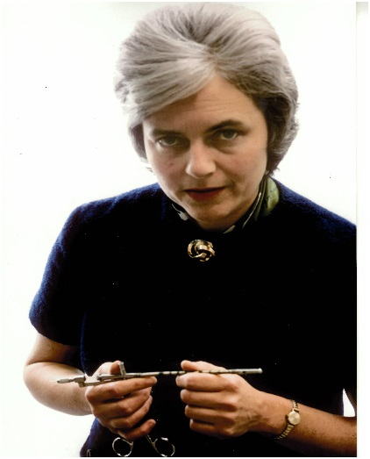

Slide 40
The role of further investigations
Rectal biopsy
  suction – nil anaesthetic; < 3 months
  open – general anaesthetic
  exclude Hirschsprung disease
  exclude cows’ milk protein allergy

Slide 41
The role of further investigations
Contrast enema

Slide 42
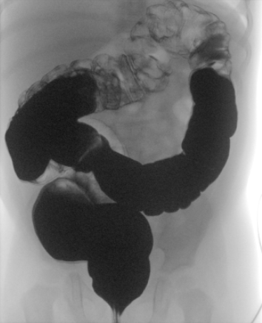
Contrast enema

Slide 43
The role of further investigations
Nuclear transit study

Slide 44
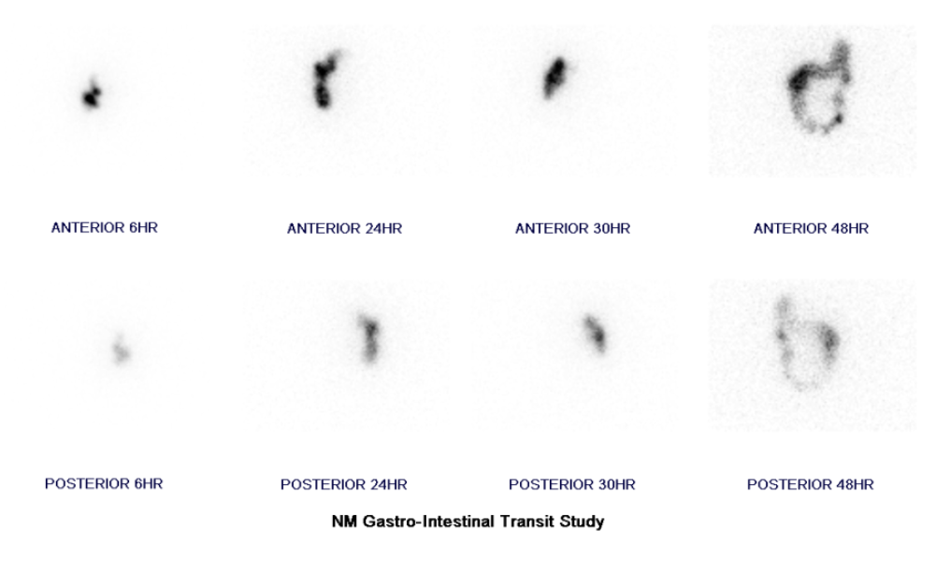
Nuclear transit study

Slide 45
The role of interventions
Appendicostomy for washouts

Slide 46
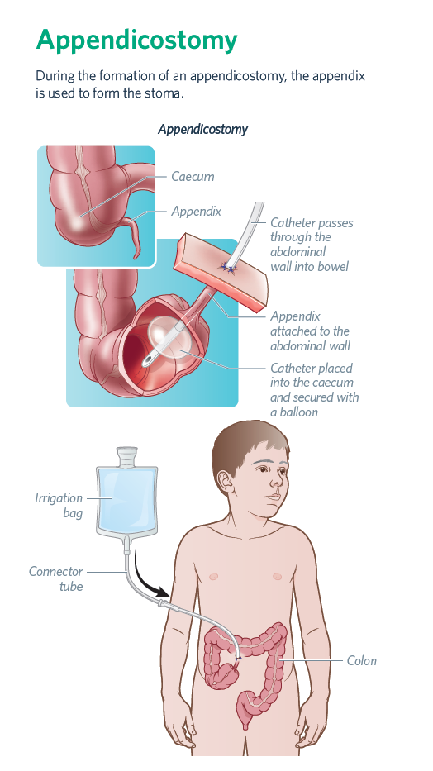
Appendicostomy

Slide 47
Long-term outcomes

Slide 48


Slide 50
sebastian.king@rch.org.au www.rch.org.au/cprs
Paediatric Constipation

