Slide 1
CDIS House Keeping
Child Development Information System (CDIS)
CDIS Users Group (Clinical)
Monday 25th July 8:30 am – 9:30 am

Slide 2
Contents
Resources
Support – CDIS Users
Support – CDIS Support Teams
OPEN/CHANGE/CLOSE
When to Close Records
Relationships
Consent
Address
Remember the Importance of
Referrals
Generic Referrals
Flags

Slide 3
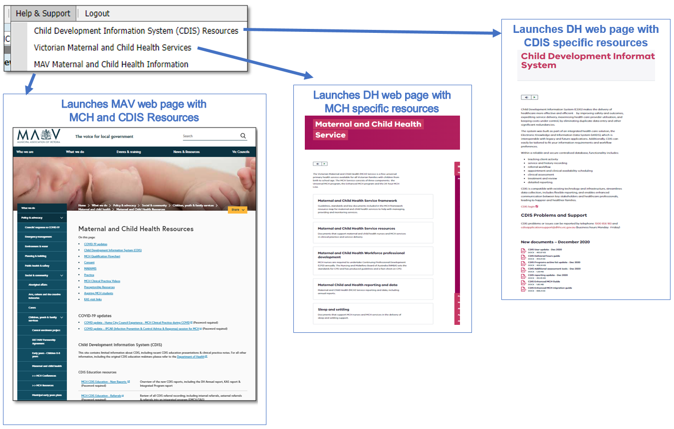
Resources
Vimeo password = cdis
Notes:
Password for vimeos = cdis

Slide 4
Support – CDIS Users
When you are experiencing a CDIS issue / problem / question:
Check internally with your team leader / coordinator / CDIS Champions to validate what’s happening
Check the online resources available to you, and if you're not closer to resolution, escalate to Contact CDIS Helpdesk on 1300 856 183 or CDISApplicationSupport@dhhs.vic.gov.au with the following important detail
In summary what is question or problem?
What screen are you using / what actions are you doing in CDIS,
What is the outcome you’re expecting?
What is actually happening instead?
NB: Client ID
Take a screen capture of the error / copy and paste the URL (web address), name the screen you’re in, and for reports, detail the year or data range and any other data selections, and capture the error message
Are you the only one with the issue or are others experiencing this too? When was this problem first noticed?

Slide 5
Support – Support Teams
Record issue / question /problem and assign Incident #
Triage > Fix on first contact if possible >
If Technical the helpdesk will review and resolve
If Clinical the helpdesk will assign it to the clinical team to review and resolve
If either team requires the issue to be escalated to supplier this is done
Clinical team in DH MCH reviews and responds, and if required, consults with Clinical experts in DH, MAV and CDIS reference group

Slide 6
OPEN/CHANGE/CLOSE
Client records should be OPEN for Universal service, which means they are active or receiving maternal and child health service (previously referred to as enrolled)
Who should be open:
• All children eligible for MCH service
• All Primary Caregivers
*Only activity in open records are in reports and funding is based on number of open records.

Slide 7
When to Close Records
When a child dies/stillborn
When a child moves permanently overseas
When a child moves permanently interstate.
As funding is based on OPEN records only, records that are closed are not counted in service funding.
Even though we are a voluntary service, MCH services should be proactive and offer “assertive outreach”, example if a client says declines MCH support, we would encourage a response such as “Are you happy if we contact you periodically to check in and see if you would like a key age and stage visit at a later stage”.
If a client adamantly declines service, add an edit note “Client declining service”, untick the consent for contact in the client details screen but leave them “Open”. There are examples of clients who have declined service in past, making contact for review when child is older, the KAS consults have then been conducted in closed records and have not been counted in reporting or included in numbers for funding.
Closed clients will also not appear on Missed visit reports.

Slide 8
Relationships
Under client details
Client relationships – important that these are always kept up to date
Family relationships must be added from this screen
Perform a state wide search and use the correct record if found, do not create a new record if not needed.
Every child should have at least one contact that is a primary care giver
https://vimeo.com/432021489 - CDIS education video that will step you through the process.
Only Primary Care givers or Caregivers of children should be ticked as information sharing in a child record.
Ensure “contactable” is ticked if you want to be able to send SMS to the PCG or care giver.

Slide 9
Consent
Consent needs to be obtained for the “Victorian MCH Service”
Process for consent tends to be LGA specific
If obtaining “written consent” this should be upload into CDIS, verbal consent is also acceptable and should be recorded as such in CDIS.
Consent must be recorded under client details>Consent
Ticking consent at the bottom of the Pregnancy & Delivery screen under History/Notes is not adequate.

Slide 10
Address
To ensure integrity of Date in the CDIS record.
Should ask at consult, are you still at the same address and check
If address needs updating go to Client Details>Client addresses.
When you have update the address – DO NOT tick to update the other family members records, as this deletes the last address in the record. Each record needs to be updated individually.

Slide 11
Remember the Importance of
When adding;
Counselling
Additional needs
Referral reasons
MCH nurse must always click on the Green
Otherwise the details/notes will not be added to the CDIS record
and Referrals will not be correctly completed.
There is no fail safe that stops you from proceeding without clicking the green button

Slide 12
Referrals
Do not add any new service providers into CDIS for referrals
When searching for a referrer
Under Organisation enter “generic” click search
A list of generic referral types will appear and choose one of these.
External referral should still be completed in CDIS, if the agency has their own referral form. State in text box
i.e. “See attached referral to Community Health – Speech.”
Referral status should be updated in clients referral screen to active once submitted and then completed once acknowledged (or declined if notified by service)

Slide 13
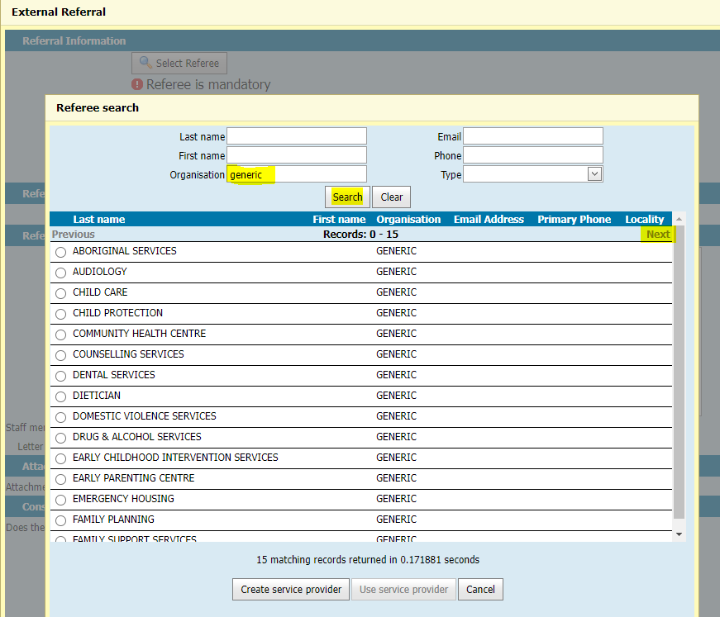
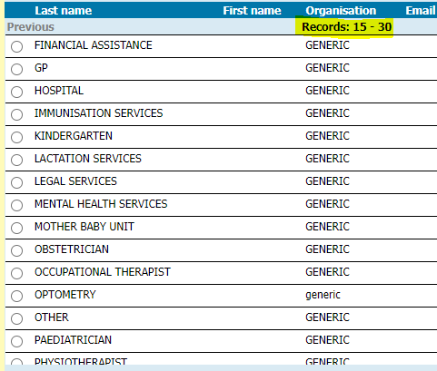
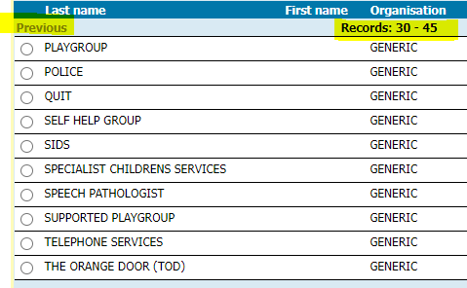
Generic Referrals

Slide 14
Flags
Flags should be added with a note to state more clearly the purpose of flag.
Flags should be reviewed and closed when risk no longer present.
Blue Flags should be added for referrals and closed when completed.
Program flags should be closed, when closed from the Program i.e., EMCH.

