Slide 1
CDIS House Keeping
Child Development Information System (CDIS)
CDIS Users Group (Admin)
Tuesday 26th July 11:00 am – 12:00 pm

Slide 2
Child Development Information System (CDIS)
CDIS Users Group (Admin)
Tuesday 26th July 11:00 am – 12:00 pm

Slide 3
Topic
Resources
Support – CDIS Users
Support – CDIS Support Teams
Calendar Set-up
Calendar icons / legend
SMS
Edit Bar
Open/Closed Files
Relationships
Childhood history
Stillborn
Transfers
Birth Notification List
Group Admin

Slide 4
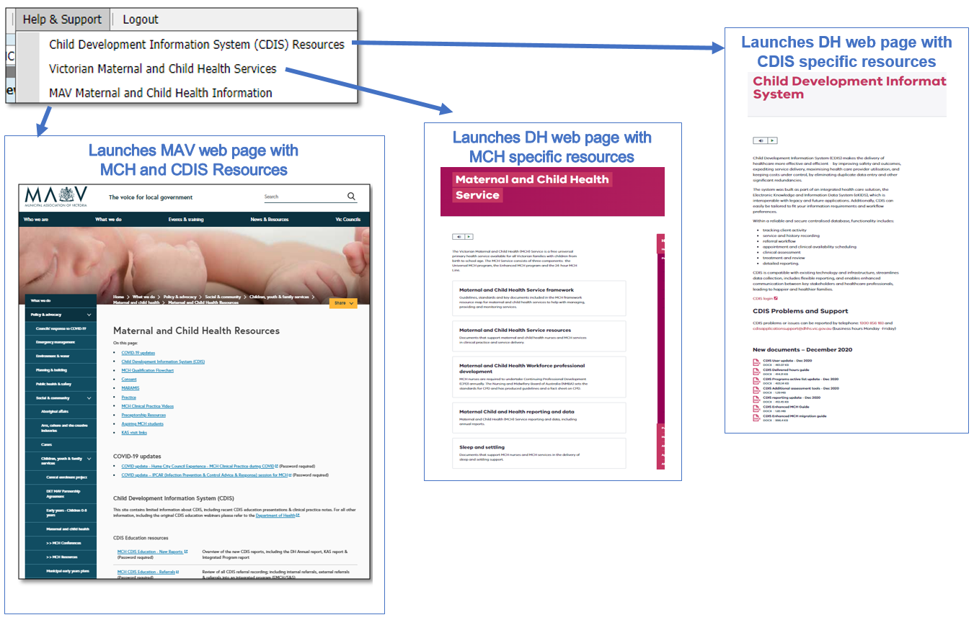
Resources
Vimeo password = cdis
Notes:
Password for vimeos = cdis

Slide 5
Support – CDIS Users
When you are experiencing a CDIS issue / problem / question:
Check internally with your team leader / coordinator / CDIS Champions to validate what’s happening
Check the online resources available to you, and if you're not closer to resolution, escalate to Contact CDIS Helpdesk on 1300 856 183 or CDISApplicationSupport@dhhs.vic.gov.au with the following important detail
In summary what is question or problem?
  What screen are you using / what actions are you doing in CDIS,
  What is the outcome you’re expecting?
  What is actually happening instead?
  NB: Client ID
Take a screen capture of the error / copy and paste the URL (web address), name the screen you’re in, and for reports, detail the year or data range and any other data selections, and capture the error message
Are you the only one with the issue or are others experiencing this too? When was this problem first noticed?

Slide 6
Support – Support Teams
Record issue / question /problem and assign Incident #
Triage > Fix on first contact if possible >
If Technical the helpdesk will review and resolve
If Clinical the helpdesk will assign it to the clinical team to review and resolve
  If either team requires the issue to be escalated to supplier this is done
Clinical team in DH MCH reviews and responds, and if required, consults with Clinical experts in DH, MAV and CDIS reference group

Slide 7
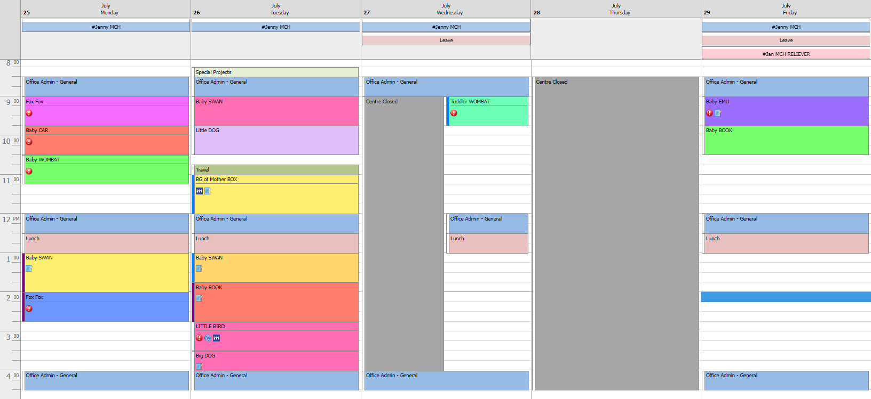
Notes:
This is a snip of a possible CDIS calendar
Staff names have been added at the top of the calendar as a work around as the calendar is assigned to a site, not a person. To achieve this, the staff member is created as a closed MCH client, with a hashtag before the staff member name to make it easy to find the staff member on a search. The booking is made as an all day appointment so that it appears at the top of the calendar.

Slide 8
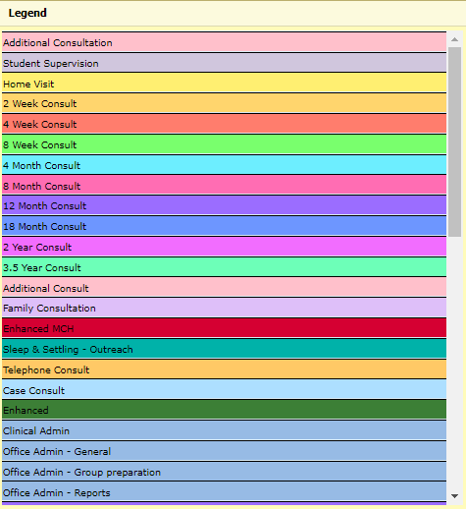
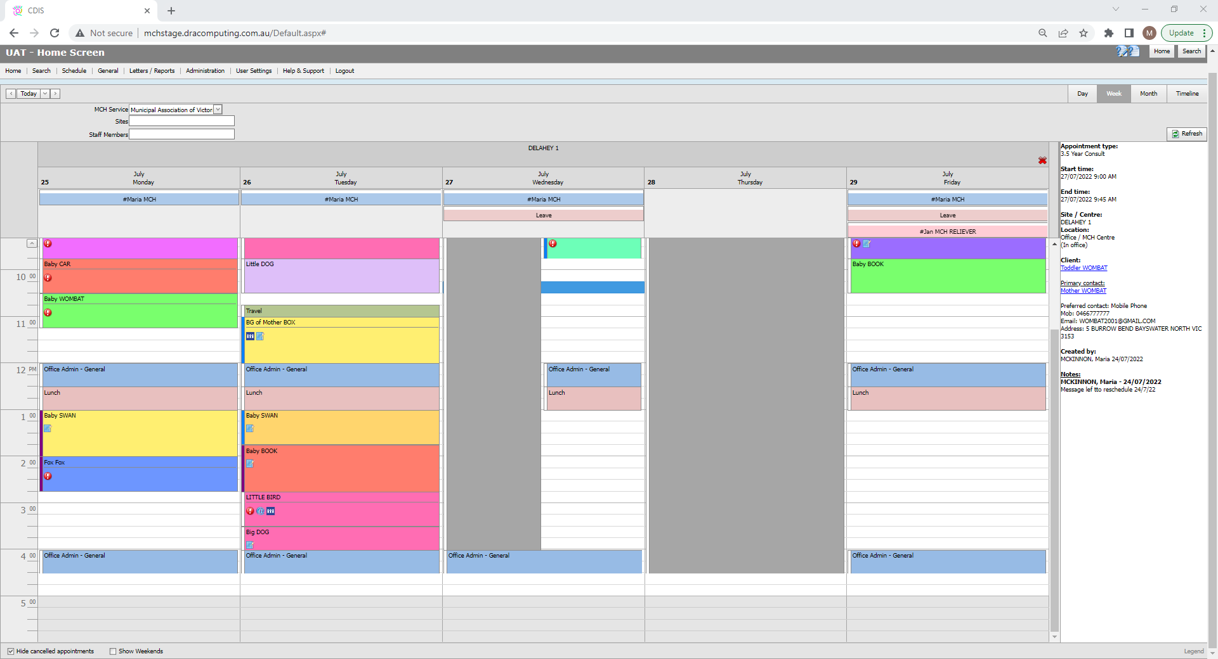
Legend
Notes:
Appointments are colour coded in accordance with the legend that can be located on the bottom right corner of the screen

Slide 9
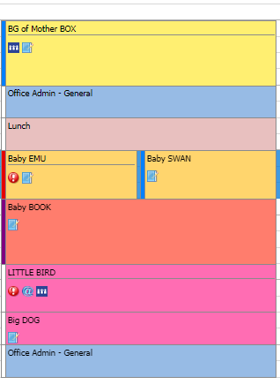

Legend
&
Icons
Interpreter required
Blue Bar-Appointment not confirmed
Red bar-Cancelled appointment
Risk factor flag or alert on history
Calendar-Important Booking Note
Purple Bar-Home visit or telephone consult
Email appointment reminder sent
SMS appointment reminder sent
Notes:
Some appointments will have code icons that serve as an administration tool reminder.
The exclamation mark denotes a red flag alert on the history
The universal interpreter sign flags that an interpreter booking is required.
The @ sign indicates that a appointment reminder has been sent as an email
The phone icon indicates that an appointment was sent as SMS
The note book signifies that there is an appointment note on the right hand side of the calendar. This is a useful tool when leaving messages such as “voice message left to confirm HV” or “additional weight check required”.
The blue coloured bar on the left of an appointment means that the appointment is not confirmed,
White bar means confirmed
Purple means Consultation is at home or a telephone consult
And the red bar means the appointment was cancelled and is only visible when unticking the “hide cancelled appointments box” at the very bottom left of the calendar.

Slide 10
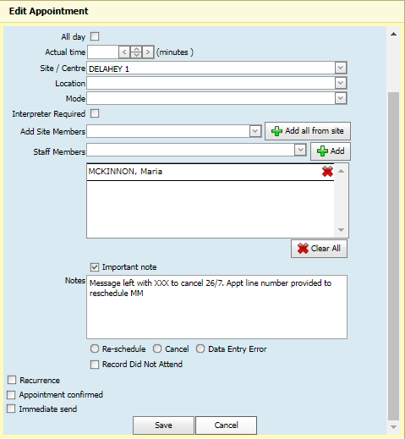
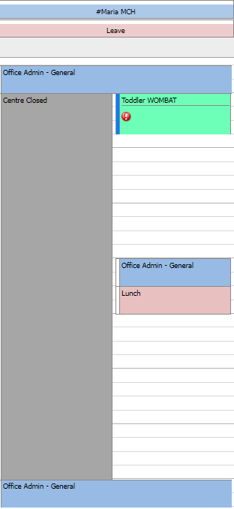
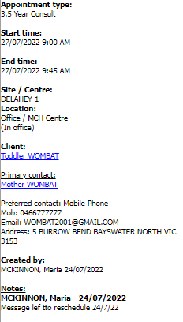
Appointment Unconfirmed
Untick Appointment Confirmed
Notes:
This snip highlights that the process of rescheduling appointments from a closed calendar.
The appointment should be edited to untick the appointment confirmed and generate reminder boxes and an important note added to the free text box indicating the attempt at rescheduling.
The presence of a blue bar highlights to other staff that an attempt has been made to contact this client.
Best practice would be to cancel the appointment from the calendar at the end of the business day so that it will appear in future missed visits reports.

Slide 11
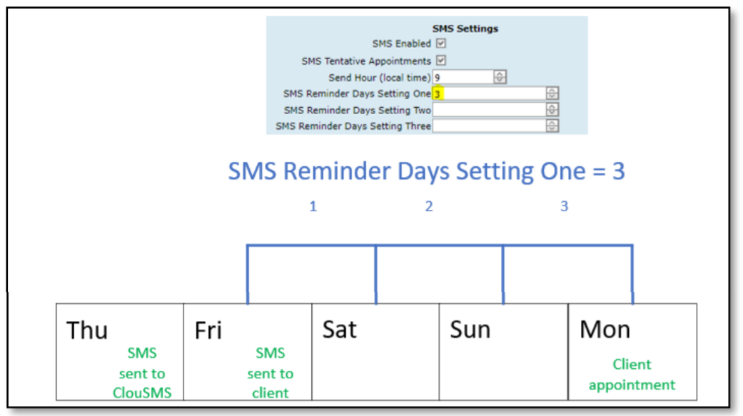
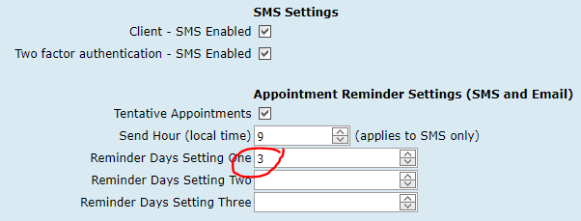
Scheduled SMS
Notes:
This table demonstrates that an appointment booked on or before 9am Thursday for the following Monday will be sent to the cloud at 9am Thursday morning. If an appointment is cancelled or rescheduled after this time, the SMS for the original message will be in the cloud and cannot be retrieved.
Any appointment created on or after 9am Thursday will only provide the immediate send option.
SMS settings can be changed by the system administrator; however most councils are likely to have chosen the SMS 3 or 2 day prior to appointment option in the administration settings.
11

Slide 12
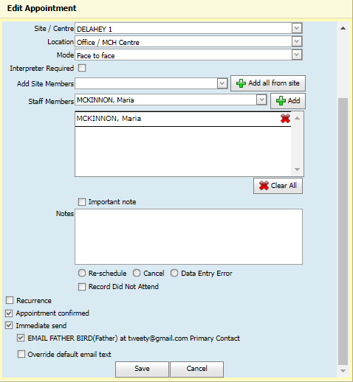
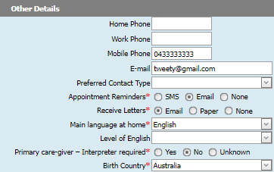
Email Appointment
reminder option
Note: Can only chose SMS OR email-not both
Notes:
An email appointment reminder is available if preferred by the client.
This is made possible by selecting the “appointment Reminder via email box in the Update client details screen and entering a valid email address.
The client must choose to get their reminder via email OR SMS-they cannot select both

Slide 13
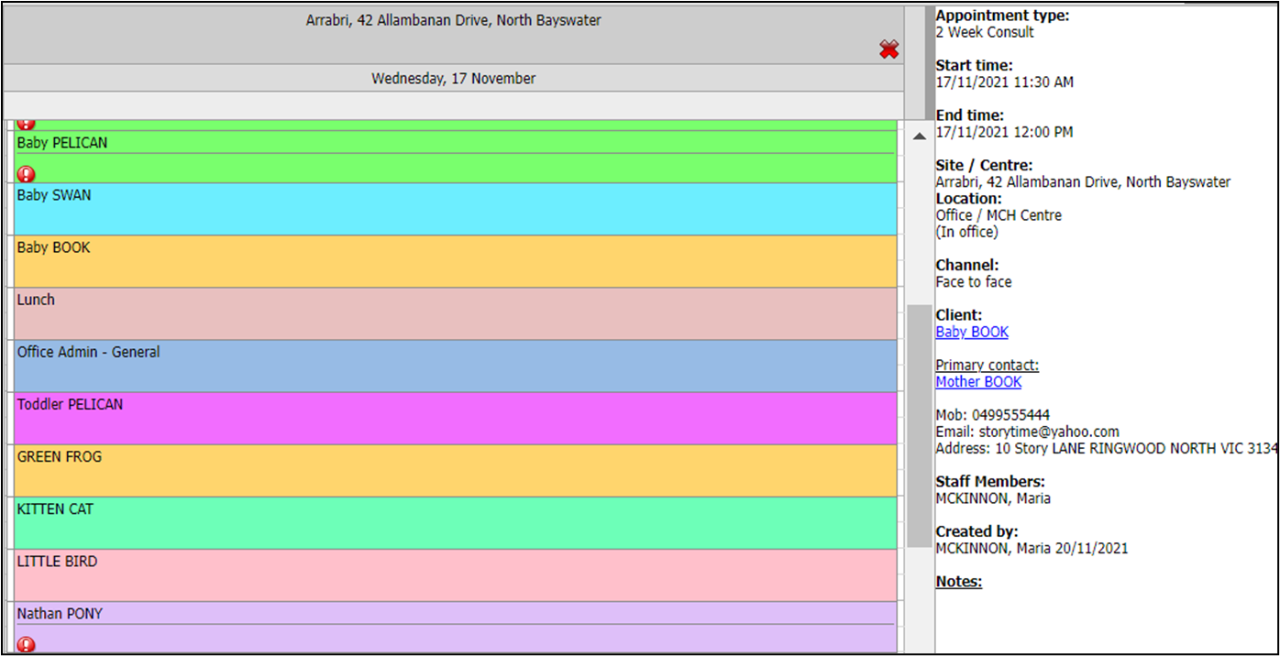
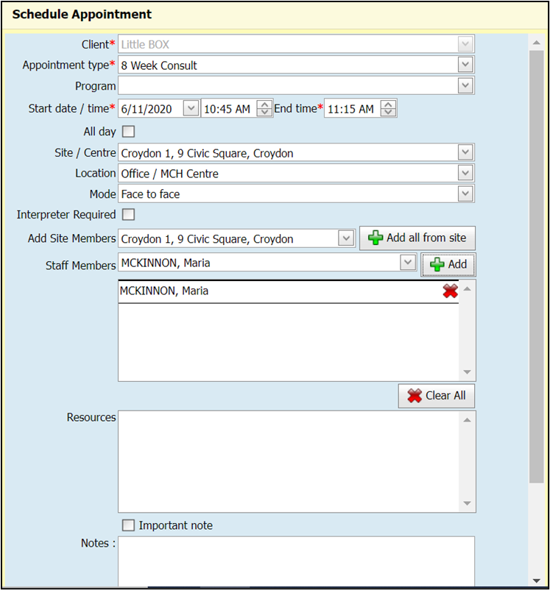

Bulk SMS reschedule
Notes:
I’m going to share a useful admin tip for when a staff member is not available, and the diary needs to be rescheduled.
To perform this, when creating an appointment, the staff member’s name needs to be selected from the staff member box. -remember to click green plus icon to add.
This does not need to be changed if a reliever ends up attending the site that day as the notes will only be recorded against the staff member who opens and saves each consultation
13

Slide 14
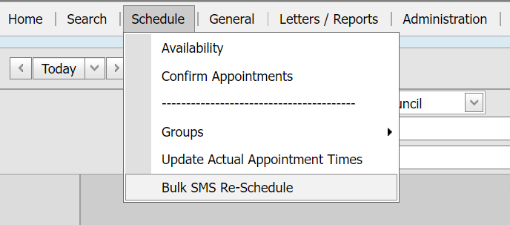
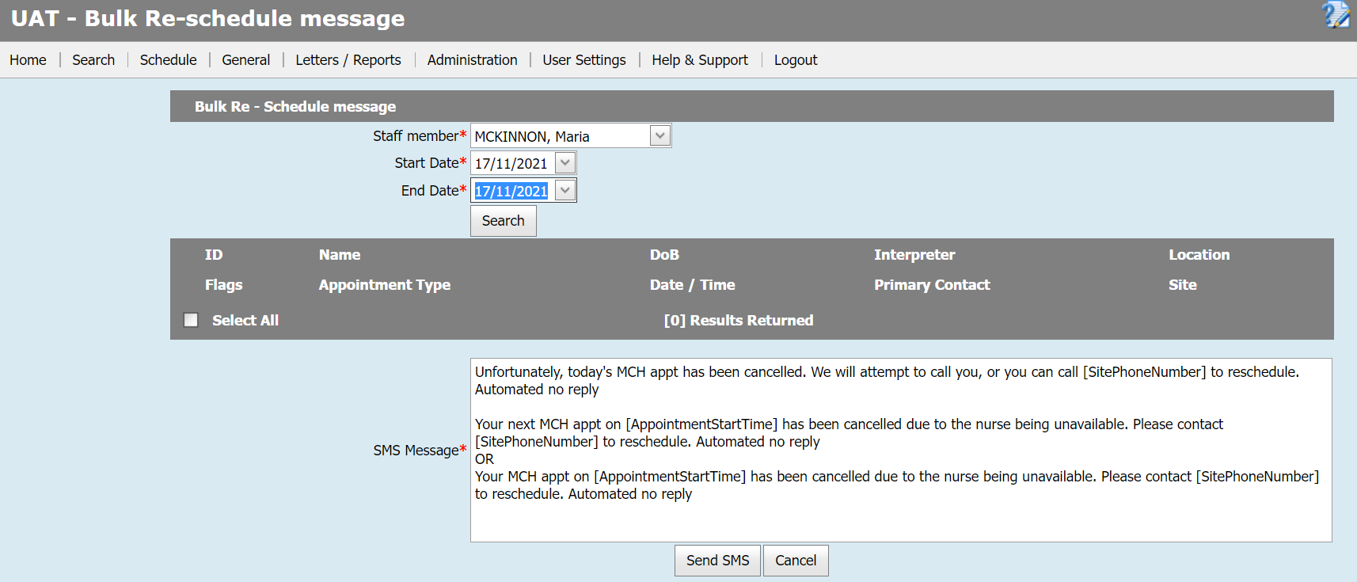

Bulk SMS reschedule
Notes:
Now go back to the home screen - select the schedule tab and click on Bulk SMS and re-schedule.
Select the staff members' name and the date or dates in question and click search.
14

Slide 15
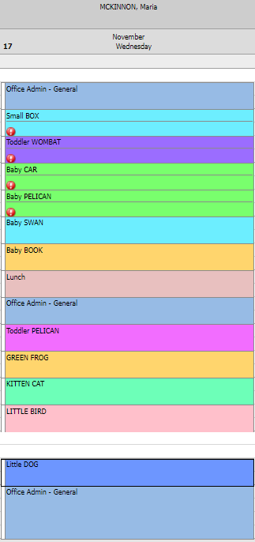
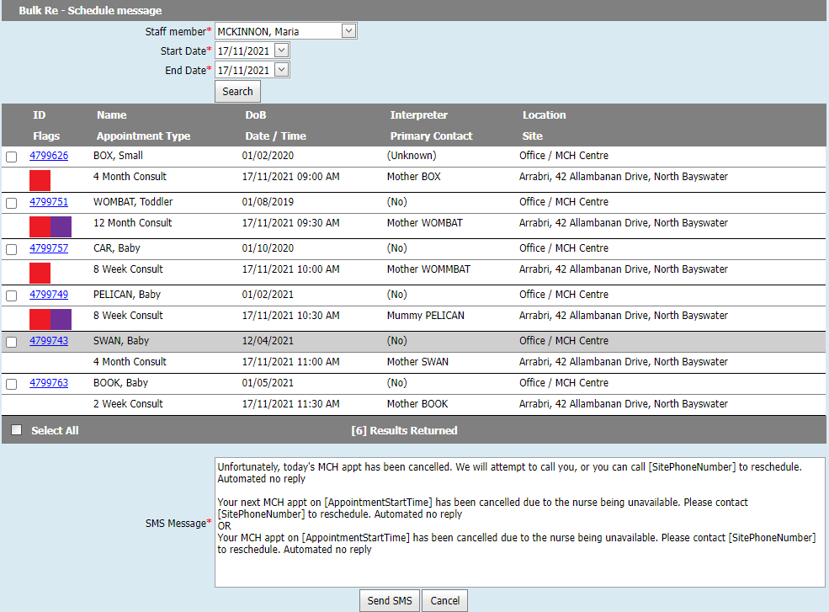
Bulk SMS reschedule
Notes:
A list of the appointments will be displayed that are booked against that staff member. Tick the box against the clients and select or override the chosen SMS message to be sent- click send SMS
In this example, I deliberately only put my name down for the 6 morning appointments to demonstrate that if I do not add a staff name to the appointment, the option to select the client for an SMS for those appointments will not be generated.
15

Slide 16
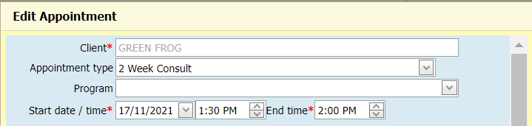
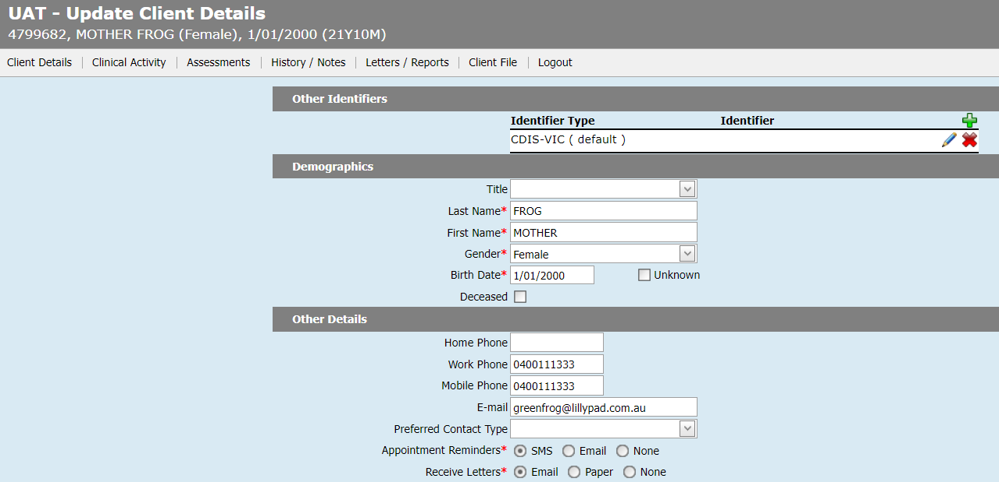
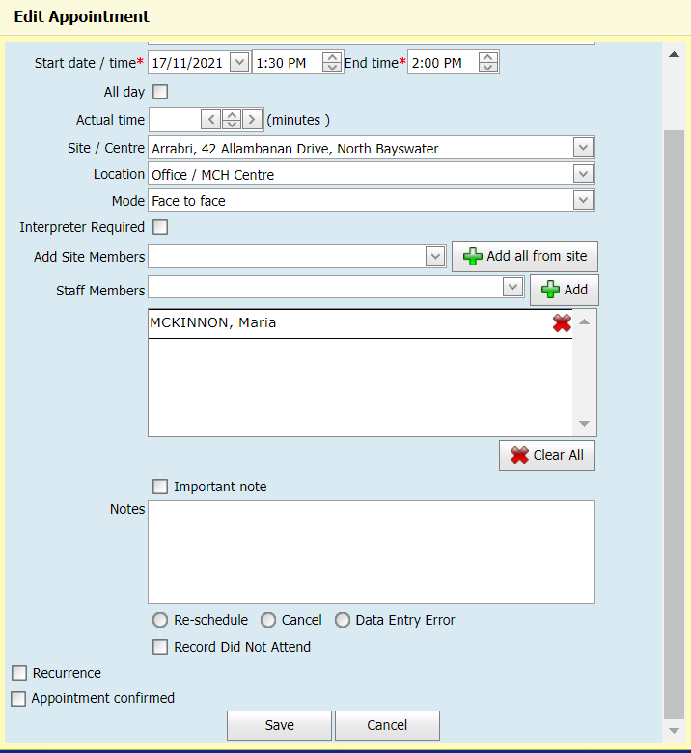



SMS reminder not visible
Notes:
On some occasions, there will not be a option to send an SMS to a client, or a client states that they are not receiving the said text.
1. A common reason for this is that the relationships are incorrect and the parent is not listed as the primary caregiver or contactable in the relationship's fields.
2. Another reason is that the SMS option is not ticked for appointment reminders in the update client details screen.
3. Also check that the mobile phone is in the mobile phone box, as the text will not be generated from the Home phone or work phone boxes.
4. Check that the client is also open for service.
16

Slide 17
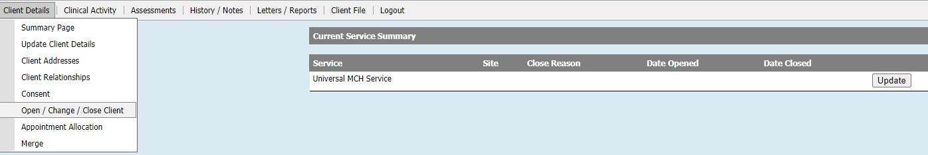
Check that client is open to MCH service
NOTE: Fathers are usually NOT open to service. In December 2020, Integrated Programs were brought into CDIS, and a change occurred that meant clients can now be referred to and seen in both Enhanced MCH and Sleep & Settling – Outreach Programs, whether they are opened or closed for service. Subsequently all client records should be checked and if closed, opened for service.
Clients that are transferred in from another municipality may have been incorrectly closed for service or when migrated may be closed to service – best practice is that clients remain open for service.
Notes:
To check that a client is open for service, go to client details and open/change/close client box. This client is currently not open.
Clients may be closed if they have migrated from another council that previously used Xpedite, been interstate or overseas or previously had a stillborn. Fathers are also usually not open to service.
Data will be missing in the reports if the client is closed but receiving service.

Slide 18
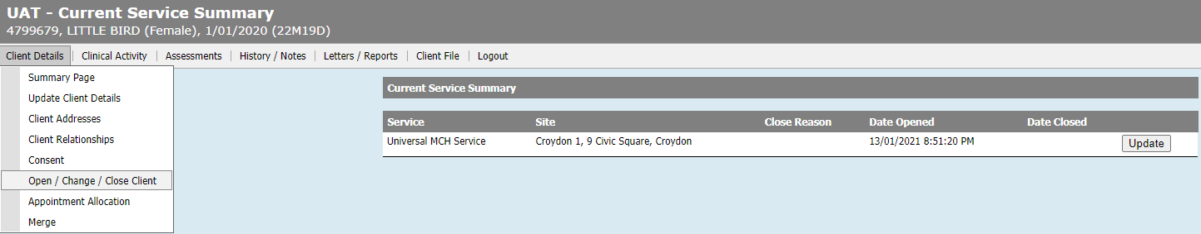
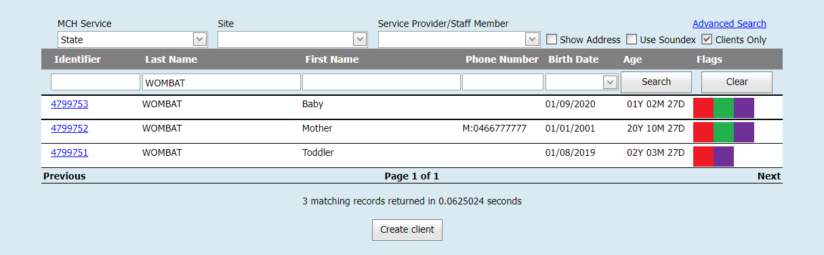
Check that client is open to MCH service
Notes:
This entry shows that the client is open to the Croydon site.
A tip for checking that a client is open when transferring in is to perform a state search with the “Clients only” box ticked. Repeating the search without this ticked will also reveal the closed histories.
18

Slide 19
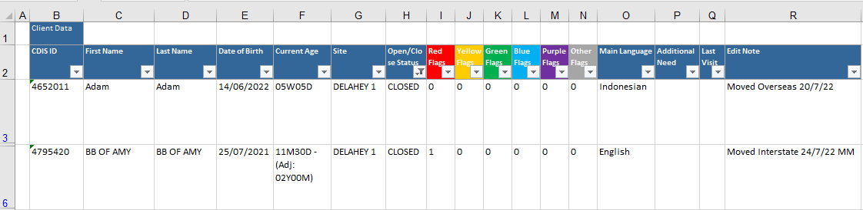
How to filter data in excel
Notes:
On the occasions that a client file is to be closed, please add a reason in the edit note tool on the client summary screen. Although this note does not become part of the actual client notes, it is useful for administration purposes as well as a reminder if a client returns from overseas or interstate.
Data extract reports can be run and filtered to locate closed files. Having a Edit note reason saves staff time on following up of clients that have a valid reason for closure.
Best Practise is that all files are open even if not receiving a service, unless they move interstate/overseas or are deceased. Childhood files should be closed when the child becomes a parent .

Slide 20
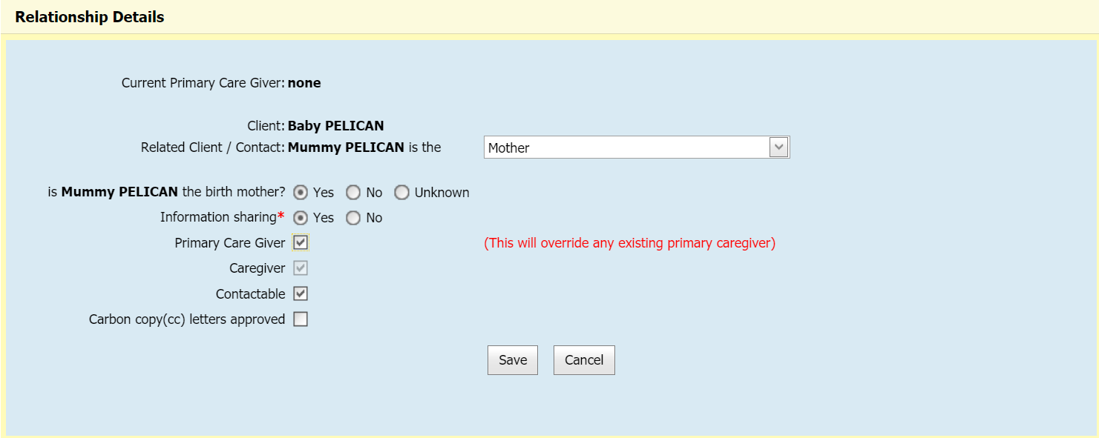
Relationships
Tip:
create
relationship from child screen

Slide 21
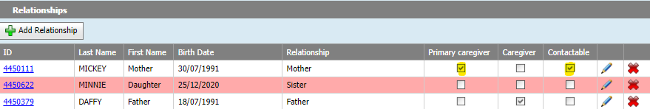
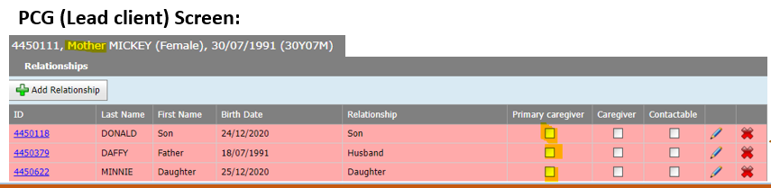
Check Relationships
Ensure that PCG relationships are correct & contactable in Childs history
Child Screen:
Ensure that the PCG status is correct
Notes:
To ensure that relationship settings are correct, it is easiest to check from the child screen.
The child should have a primary caregiver and will often have a secondary caregiver.
Note that there is no primary care giver marked when we look at the Primary Care giver screen.

Slide 22
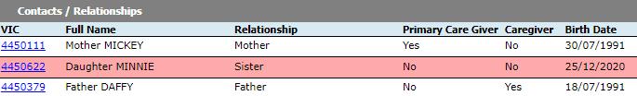
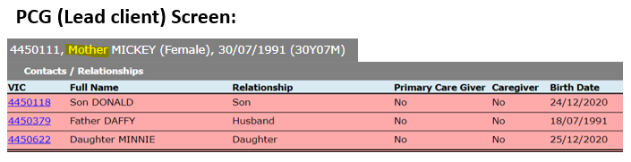
Check Information Sharing permissions
The information sharing permissions is always done from the view of the client whose record you are in. You cannot share information with any relationships that are highlighted red.
Child Screen:
You cannot share information about SON with DAUGHTER
(his sister)
You cannot share information about MOTHER with SON, DAUGHTER or FATHER
Take particular note if there is no Information Sharing with the secondary carer / partner
Notes:
The easiest way to get the relationships correct is to also work from the child screen.
The information sharing permissions is always done from the view of the client whose record you are in. You cannot share information with any relationships that are highlighted red

Slide 23
Child Record
Clients should have 2 separate records; one for when they are a child & another for when they are an adult/caregiver
*Hint: if the record is closed it may be an old child record; if the CDIS number begins with a 1/2 then it may be an old child record
Consequently, an old child record should not be utilised upon that client becoming a caregiver (i.e., parent)
Add a note to edit field “Date DO NOT USE CHILDHOOD RECORD Staff Member initials”
An adult’s relationships should be kept current in CDIS, and old relationships that are no longer relevant/active, should be disconnected eg Grandparent relationships
Notes:
We need to ensure that we are not using a child record for a client that is now an adult.
Clients should have 2 separate records; one for when they are a child & another for when they are an adult/caregiver
If your client search reveals a child history, best practice is to close the history and add a comment in the edit bar on the client summary page to state “Date DO NOT USE CHILDHOOD RECORD Staff Member initials”
An old child record should not be utilised upon that client becoming a caregiver (ie parent).
If this has occurred, notify the team leader to create a new history and copy the current notes into the new file.
The old file should be closed with a note added to edit field stating. “Date DO NOT USE CHILDHOOD RECORD Staff Member initials”
An adult’s relationships should be kept current in CDIS, and old relationships that are no longer relevant/active, should be disconnected.

Slide 24
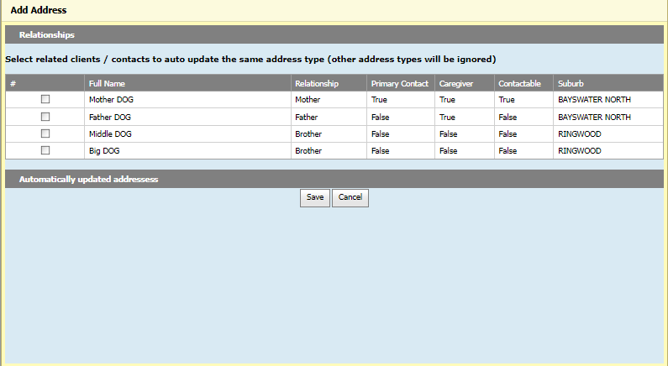
Update Address
Notes:
When updating the address for a client, a bulk update address option will open. Please do not use this auto update option as there is a glitch that erases all previous known addresses. Each client address will need to be updated individually. This is on the CDIS “wish list” to be fixed.

Slide 25
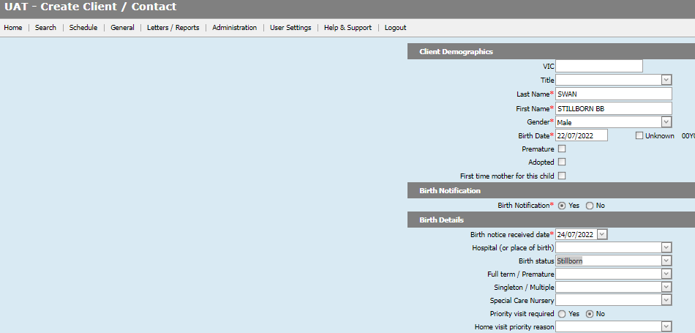

Stillborn-Create & Open Client
1.
This ensures that Birth is Counted in the Birth Notification List
and matches State figures
Notes:
Recent data that shows a large discrepancy between the official number of stillborn births in Victoria and the number recorded in CDIS. As stillborn births count in the annual Birth Notification tally, the following steps are required to ensure correct recording.
1. A key step that is required when entering a stillborn BN in CDIS is making sure that the client is opened to service.

Slide 26
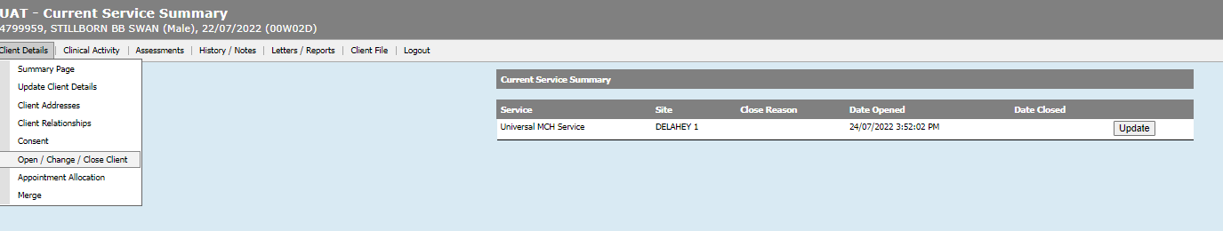
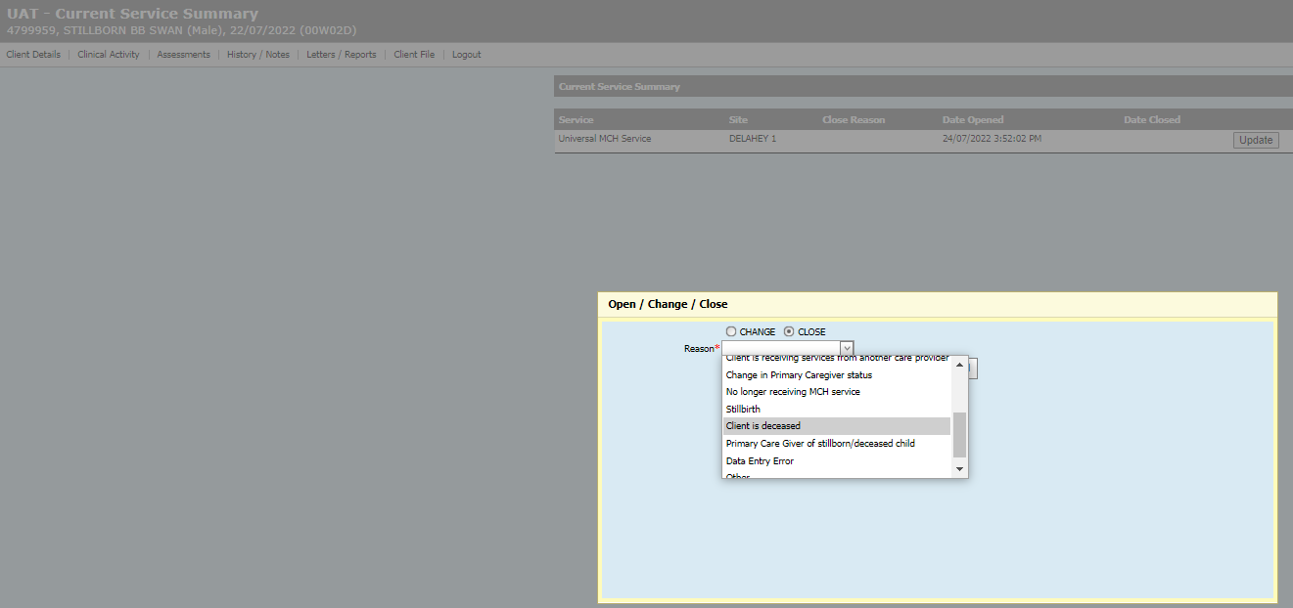
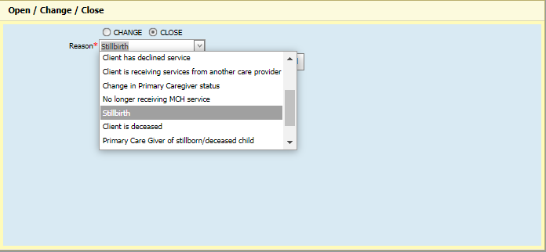
Stillborn-Close client
2.
Notes:
Step 2 is that we now close the client file via the client details - open/change/close client tab.
Select stillbirth as the reason.

Slide 27
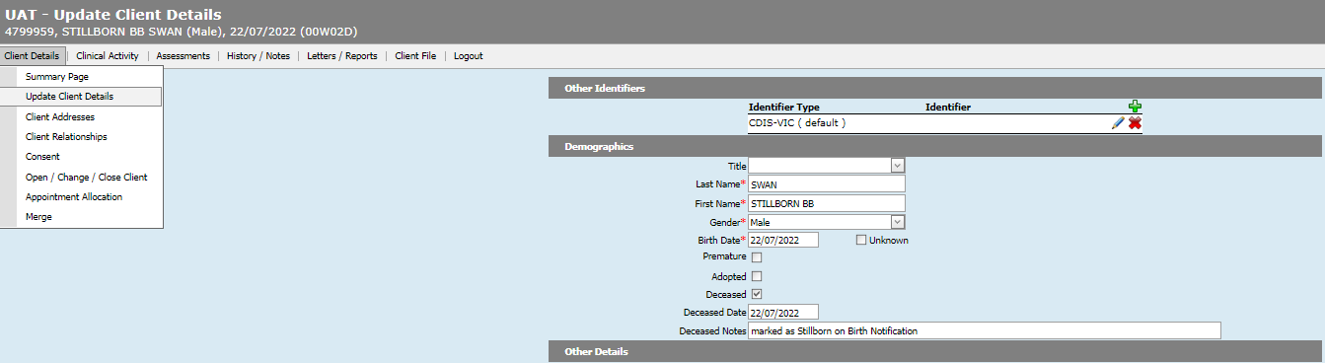
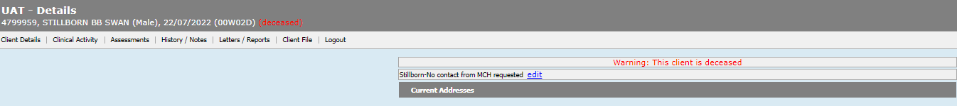
Stillborn-Update client details
3.
Notes:
Third step is to go back into the update client details screen and mark the infant as deceased.
This will cause the babies name to be in yellow italics in the client home screen.

Slide 28
Deceased Adult
Deceased adult
1. Client details > close record >select reason as deceased
2. Update client details > close > select reason as deceased > save
3. Change relationship status/contactable/Information sharing status
4. Select new Primary Care Giver and check that they are open
5. Open new primary Caregiver to service
Notes:
Similarly, a deceased adult should be closed with the reason marked as deceased.
Enter the Update client details page to mark them as deceased there as well.
Remember to update relationships, selecting a new Primary care giver if required and ensuring they are open to service.

Slide 29
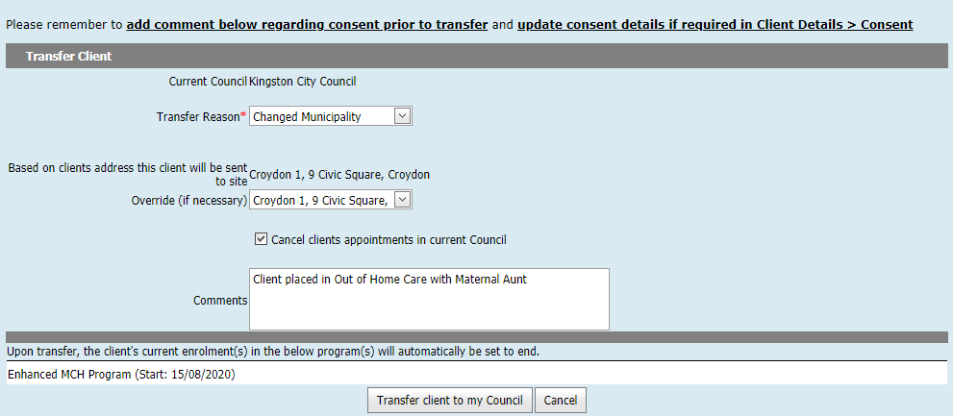
Transfer of Enhanced / S&S Client
Notes:
Careful note should be taken when transferring adults that have a current enrolment in an Enhanced or S&S program as these programs will be closed and information forfeited when transferred.
Best practice would be to have the MCH team leader contact the relevant council prior to transfer.
Best Practice is to always pull histories, never “push” or transfer a file away from your council.

Slide 30
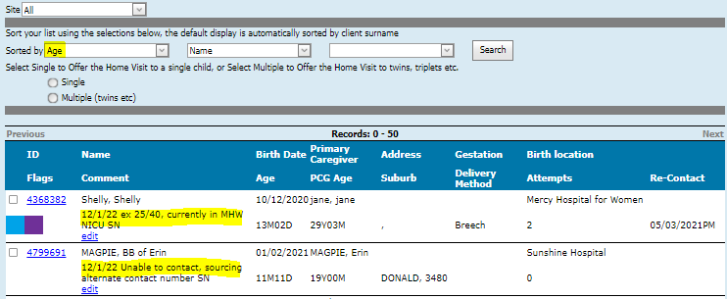
Birth Notification List
*Hint: if data is present in the delivery method column, family likely to have already had the first MCH consult
Notes:
The BN list will contain new birth notifications who have yet to have their HV confirmed.
The edit bar is a useful tool for tracking HV plans, particularly if there is a delay in the HV.
The edit bar note is for administration purposes only and does not get recorded in the clients notes as a permanent record.

Slide 31
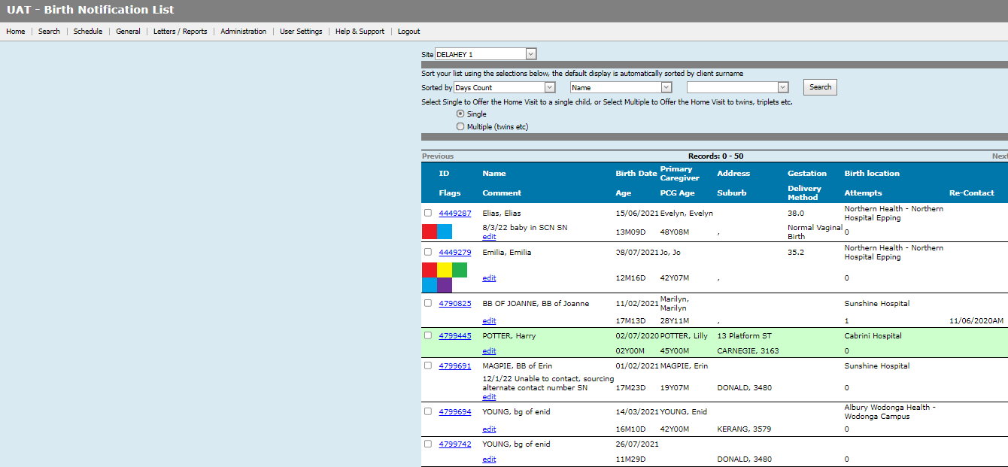
Caregivers added to Birth Notification list
Notes:
On the occasion that a previously closed client is re-opened for service, they may appear on the birth notification list.

Slide 32
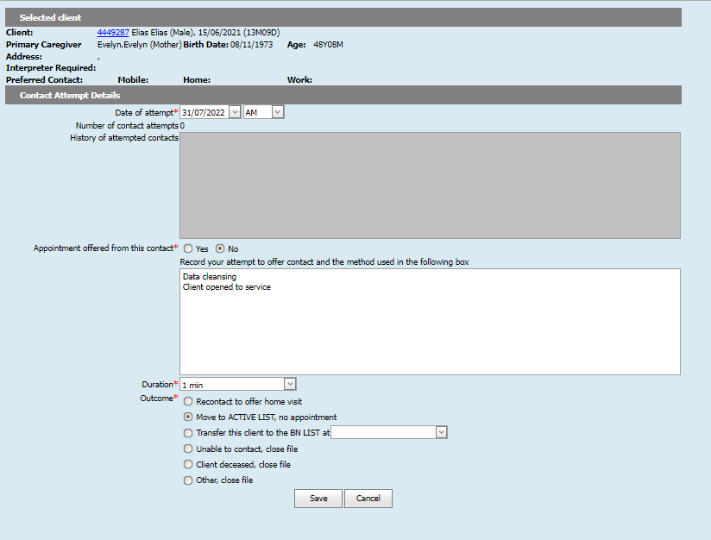
Data Cleansing BN list
Notes:
To remove them off the list, proceed tick the fields to offer an appointment but state “data cleansing-client receiving MCH service” and apply a time period of 1min.

Slide 33
Snapshot: Groups
The below table is a quick snapshot of the suggested steps required to record group administration.
As the management of groups in CDIS is required to be done in a specific order & process, the review of the Groups presentation is strongly recommended.
Step | Process | Where?
Set up original group template | Initial template setup is only to be done by specifically designated MCH staff. Do not create duplicate group templates. | See Initial groups setup process on Dept Health: CDIS website
Add new group dates | Using a pre-existing group template, add a new group start date. Calculate the number of sessions, session dates & session topics | Home>Schedule> groups> group templates> Add date
Add a facilitator | Add all facilitators who will be running the group. All facilitators (including relievers) must be added prior to adding clients to a group. | Groups>manage groups
Add Clients directly into group OR Add Clients via group waitlist | Recommended if you are confident about all attendees that will be added to the group & the date that they will attend; not requiring any triaging of participants Recommended as a means of managing group participants prior to them being added into a specific group starting date | Clients screen> clinical activity> book group Select group name> plus button, complete group offer popup Clients screen> clinical activity> book group Select group name> Add to waitlist
Manage group waitlist (if utilised) | Print group waitlist, add clients into group from the waitlist, add clients back to the waitlist, send waitlist sms’ | Schedule>Groups>Manage groups Select group name>plus button
Manage groups | Review session dates, facilitators, clients attached to a group, update client RSVP status, send client sms’, & print client list | Schedule>Groups>Manage groups
Record Attendance/Outcomes | Must record the individual observation first, if required. This cannot be done after the session note has been saved . Tick group attendance. Select notes to record generic session notes. Recommended session text: ‘All children attended with their PCG today, unless otherwise stated’ | Groups>Group attendance/outcomes Select facilitators name, Refresh. Click the plus button to open a specific group
Notes:
You may find it helpful to print out this tipsheet for future reference

Slide 34
Groups-Troubleshooting
The management of groups in CDIS is required to be done in a specific order & process. Failure to do so may result in the group not recording outcomes and attendance as anticipated.
The below table is a quick snapshot of the potential CDIS group issues.
Problem | Why? | Solution
Change/add group dates | Group has already started | No fix available
 | Clients already added to the group | Temporarily send clients to the group waitlist whilst amending group dates
Cannot record attendance/outcomes | User is not added as a facilitator | Add user as a facilitator
Can't add a facilitator | Cannot be a primary facilitator for 2 concurrent groups Clients already added to group | Resolve conflicting appts Cannot add a facilitator once clients already added to group
Cannot backdate a facilitator | Cannot change facilitators once a group is finished | No fix available
Can't find previous group info | Group templates section only shows upcoming groups | Use manage groups, input a historic date when searching
 | Facilitators are the only person who can review previous group attendance | System administrator can access other facilitators groups Run a group report to gain group/participant info
Can't record an individual's group observations | Have already finalised the session by recording the attendance/session note first | No fix. Add as a separate note in the client file
Record attendance against an unplanned client | A group invitation cannot be backdated | Can record an attendance note via an individual session note Future attendance ticking /outcome recording will be available
Notes:
You may find it helpful to print out this tipsheet for future reference

Slide 35

Questions???

