Slide 1
CDIS Universal Active List Missed Visits & Follow Up
Child Development Information System (CDIS)
CDIS Users Group (Clinical)
Monday 12th September 8:30 am – 9:30 am

Slide 2
Contents
Universal Active List
Sorting the Active List
Hyperlinks
Suggested Process for Missed Visit Follow Up
Bulk SMS
Manual Bulk SMS Process

Slide 3
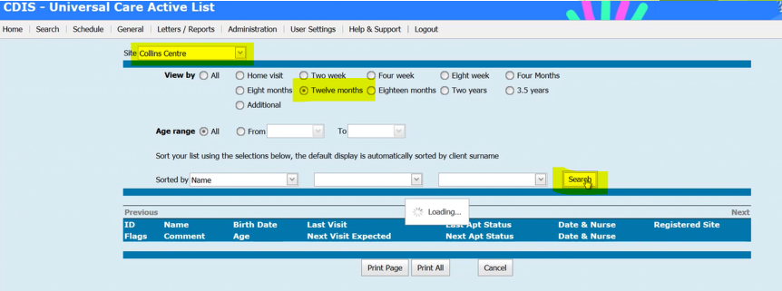
Universal Active List
Top Navigation Bar in CDIS under menu “General” is the “Universal Active List”
VIMEO - https://vimeo.com/432022192
Home screen >menu “General” >“Universal Active List
Use the Universal Active list to check for clients who are overdue for their KAS visit at a site
Choose Site > Collins Centre
Age > 12m KAS
Click > Search

Slide 4
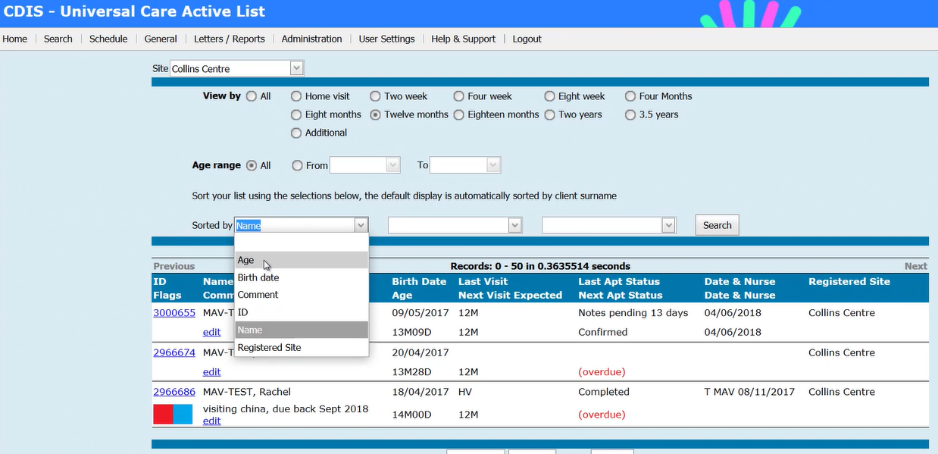
Sorting the Active List
Click on first drop down sorted by menu
Choose Age – this is usually the easiest menu to sort by.
Click Search to sort.
List of clients overdue for visit will be appear sorted by Age – oldest child will appear at top of list.

Slide 5
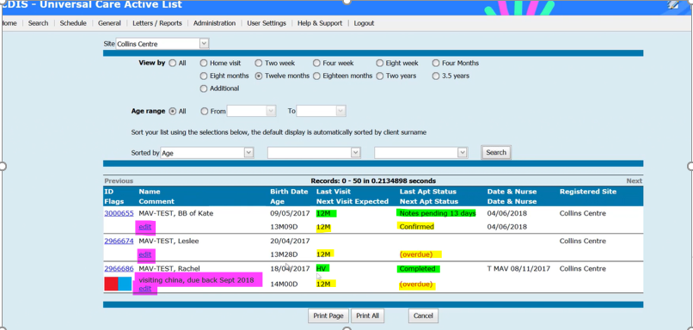
Sorting the Active List
You can then see the list of clients overdue for 12mth appt
The list will show you the age of their last visit and the next expected visit
BB of Kate is overdue for 12m KAS, you can see she has an appointment booked in the calendar – so if comes up “confirmed”
Leslee is overdue for 12m KAS – see in ref “overdue” means no appointment is booked for this KAS
The “edit” note can be used a prompt, for the person reviewing the list to be aware of something going on for the family
Rachel – we can see her Last KAS completed was the HV and there has been a service gap. AS you can see there is an “Edit note” explaining that child was in China and when she was due back.
Rachel is now overdue for 12m KAS with no appt booked
BB of Kate also has “notes pending for last appt status, this indicates the appointment remains in the CDIS calendar, not completed and not cancelled.
The list also allows you to see if there are any flags pertaining to the child and can help you to prioritise who to contact first.

Slide 6
Scenario 1:
The child above is now nearly 11m but were not flagged as overdue as there had been an 8m appointment scheduled, but it was a cancelled as a DNA fro 8m KAS – client requires contact for new appt.
Scenario 2:
Child who is already 11m and marked as “tentative” does not come up with overdue as there is a 8m KAS booking in the past that was not attended or cancelled on 23/5/22, so notes are pending from that date (as consult was not commenced).
Scenario 3
Client who is just over 8m was a DNA/Cancelled 4m KAS. As there is no 8m appointment date, it is flagged as overdue.
Scenario 4
Child just over 8m has notes pending from a 4m KAS that was not attended or cancelled from the calendar. As there is no 8m appointment date, it is flagged as overdue.

Slide 7
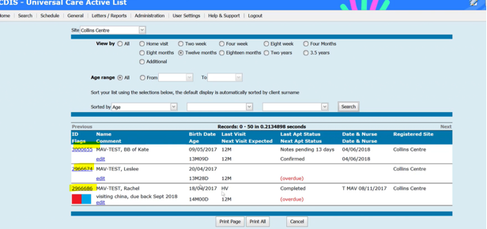
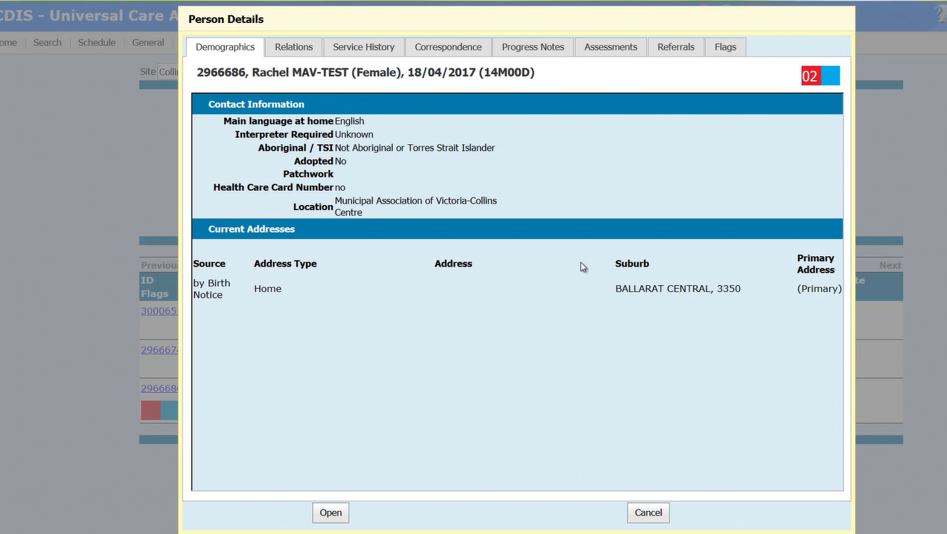
Hyperlinks
You can see that the CDIS ID is blue – this is a hyperlink to the child's CDIS record.
If you click on the Hyperlink on their CDIS ID it will create a pop up record.
From the pop up record – you can click on the tabs in the top menu to review information
Click on “Relations” for contact details to contact family re missed appointment.
You can also see the “progress notes” from last appointment, review any flags etc or open the full record by clicking “open” at the bottom of the screen.

Slide 8
Suggested Process for Missed Visit Follow Up
Process LGA specific – review your own MCH service’s protocol
Suggested process:
Regular monthly (at least) review of missed visits for each site/centre.
Phone call to client to book appointment
If no answer, leave a voice message.
Send a follow up SMS from CDIS if you don’t manage to speak to client.
Pop a note into the “edit” section of Universal Active list i.e “31/8/22 TC to client re missed visit, message left and follow up SMS sent. AS”
If you speak to client, record contact under “Client not present”
If you call client and leave a message, also record contact in client notes via “client not present”. ie. “Call to Rachel re missed 12m visit, no answer, voice message left on mobile”.
Also check parent and sibling notes for updated details such as a new phone number or address that may not have updated in child record.

Slide 9
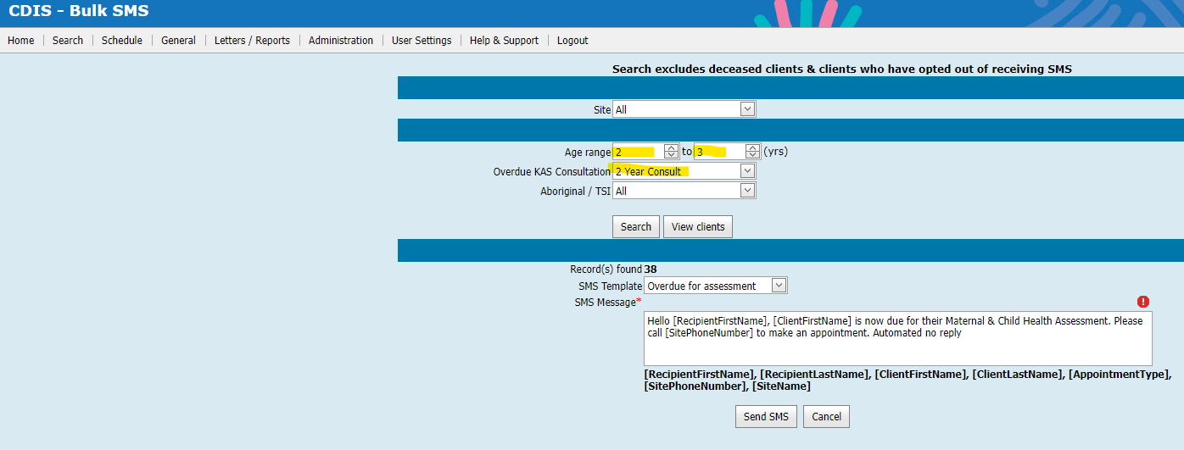
Bulk SMS
The Bulk sms function in CDIS is available to send bulk ‘overdue’ KAS SMS reminders to families
Please note that many LGAs are choosing not to utilise this function due to the age parameters set for the ‘overdue KAS’
Overdue 12m KAS will be any child between age of 12m-18m who hasn’t yet had the 12m KAS (i.e. children who at 17m3w will get an overdue KAS reminder).
Overdue 18m KAS will be overdue children between 18m-2y
Overdue 2y KAS will be any overdue child between 2y-3.5y. *
If an age range of 2-3 years is put in this will restrict this to children between 2y-3y (i.e. 2y11.5m will get an overdue KAS reminder)

Slide 10
Bulk SMS
If utilising the 3.5y KAS, you must ensure to put age range of up to 4years, or else it will include children above this age. Again, this list will include children 3y11.5m getting an overdue 3.5yr KAS reminder
It will not pick up children who are technically not listed as ‘overdue’ in the universal active list, as per demonstrations in previous slides
You cannot click view clients to check who will receive the SMS but you cannot select clients who will receive this reminder, it is all or none.
This will SMS all clients overdue at the time of the report, therefore if run regularly clients within those age parameters will get a new SMS reminder each time.
This SMS correspondence will be saved in the client file.

Slide 11
Manual Bulk SMS Process
Consequently, many MCH Services are creating a manual report of children overdue their KAS, within reduced age parameters
This data is used to send a bulk KAS reminder via an alternative SMS/email service.
This report is run through Letters/Reports>Data Extract> Universal Active list report
Put in selected dates that match appropriate age parameters
I.e. for 2y KAS reminders would put in date range between 2yo-2.3yo (12/6/2020-12/9/2020)
This will show ALL CHILDREN in your MCH Service within this age range.
This can be done for the whole LGA or independent centres.
***For larger municipalities this report may be difficult to run for a large client group.

Slide 12
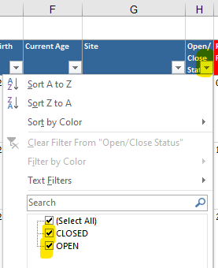
Manual Bulk SMS Process
This excel report can then be filtered to include only children overdue the KAS
Click anywhere on the sheet
Select Data> Filter
The columns will now have filter options (by clicking on arrow next to the column)
*Demonstration of excel filtering available in Data cleansing training webinar
https://vimeo.com/690719160

Slide 13
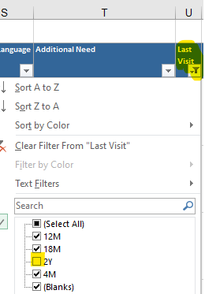
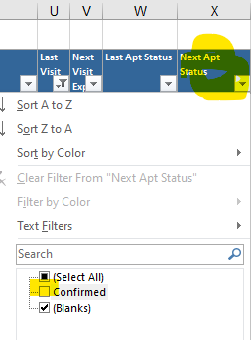
Manual Bulk SMS Process
For Bulk SMS reminders it is recommended to review & filter the following:
Double check the child age parameters you have run off is correct
Filter out all closed records
Filter out those who have already had the KAS you are doing the reminder for
(i.e. if doing 2y KAS reminder, filter out Last visit >2y)
Filter out those who have their 2y KAS appointment booked.
Via Next Apt status>confirmed
Filtering by flags is available if further prioritisation required.

Slide 14
Manual Bulk SMS Process
This will provide you with a list of children, within the set age parameter, who have not yet had nor booked the KAS selected
You can scroll across to the PCG field to gather the mobile number/email to send a KAS reminder to. This can be done by an external sms provider or email service.
This will assist in the overdue KAS issue shown in previous slide, but as it is a workaround there is still a risk that some clients may ‘slip through’ this reminder process
This method is best utilised for a blanket follow up of a large number of clients. The individual calling & reviewing of the universal active list is best practice for follow up of vulnerable clients in particular.
This method will not document any correspondence in the clients CDIS record.

